Slide 1


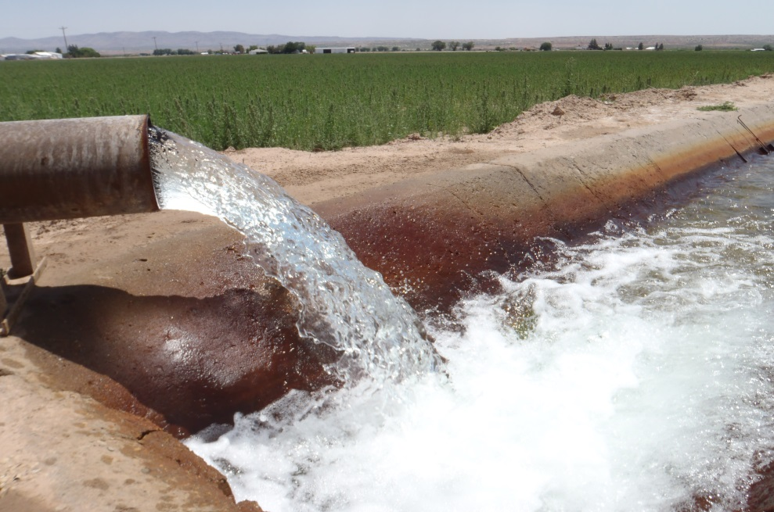
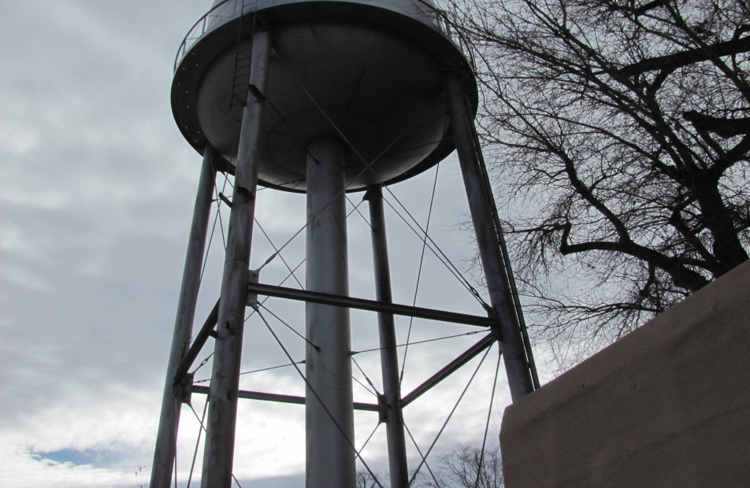

Emergency Response, Operation & Maintenance, and Distribution System Sampling Plan
Peter Nathanson, P.E.
Daniel B. Stephens & Associates, Inc.
Notes:
<number>
Introductions
Have participants introduce themselves, say what system they are with, how many connections, and what they hope to get out of the training.

Slide 2

Agenda
Why – Importance, application
What – Plan components
How – Prepare a plan for your system
Notes:
<number>

Slide 3
Emergency Response Plan
Notes:
<number>

Slide 4
Emergency Response Plan
Required when applying for approval from NMED for a water system project
20.7.10.200.A, 20.7.10.201.A NMAC
Emergency notification requirements:
Groundwater:
20.7.10.400.E NMAC, 40 CFR 141.403(a)(4)
Surface Water:
20.7.10.400.E NMAC, 40 CFR 141.723(b), 403(a)(4)
Notes:
SDWIS is the State Drinking Water Information System -
The Safe Drinking Water Act requires states to report drinking water information periodically to EPA. This information is maintained in a federal database, the SDWIS Fed Data Warehouse.
<number>

Slide 5

Importance
Protecting public health
Convey to the State, funding agencies, and others that the system understands the importance of emergency response.
Notes:
<number>

Slide 6

Value for your system?
Identifies likely threats
List of contacts
Emergency event communication
Emergency plans, actions, procedures
Evaluates inventory
Identification of critical/valuable customers
Training
Notes:
<number>

Slide 7
Template
NMED Drinking Water Bureau
Applications and Forms
Emergency Response Plan
https://www.env.nm.gov/drinking_water/applications-and-forms/
Notes:
<number>

Slide 8
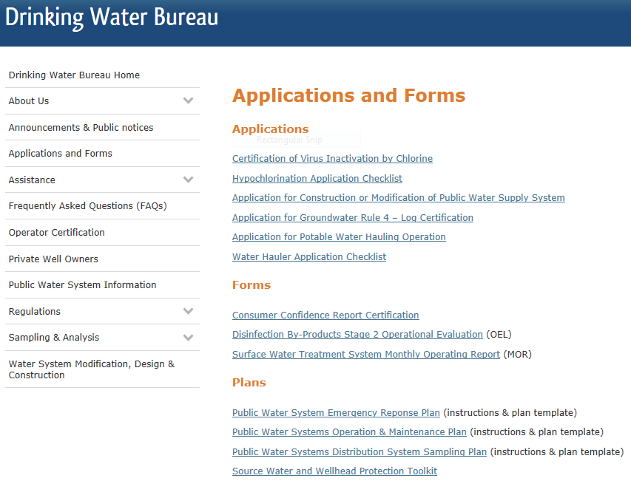

Slide 9
Other Resources
Drinking Water Watch;
https://dww.water.net.env.nm.gov/NMDWW/
Tools & Resources Emergency Response & Security category; https://www.env.nm.gov/drinking_water/resources/
EPA Water Utilities Response On-the-Go;
https://www.epa.gov/waterutilityresponse/water-utility- response-go-mobile-application-and-website
Notes:
<number>

Slide 10
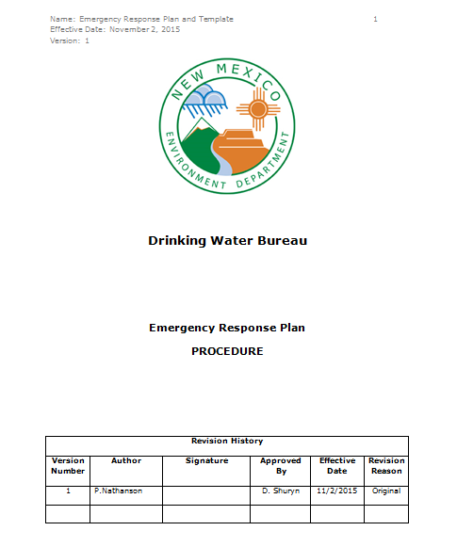
What’s in the template?
Introduction, general information
Guidance with examples
Planning Template
Notes:
<number>

Slide 11

ERP Components
1. Emergency response mission and goals
Helps the system focus on the important aspects
Should include the obligation to protect public health, safety of customer and staff, and assets.
Outlines what needs to be accomplished in an emergency
Notes:
<number>

Slide 12
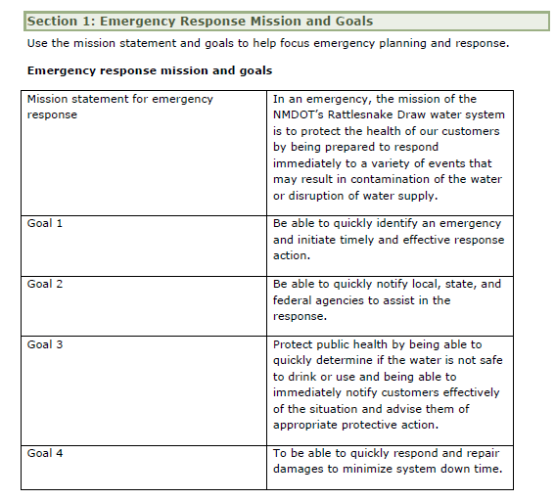
Example
Notes:
Examples are from an NMDOT rest area, transient, non-community water system with one well, tank, booster station, nitrate treatment, distribution
<number>

Slide 13
ERP Components
2. System information
Information available for system personnel and external parties
Information needed:
System name and ID
Address/location (directions if necessary)
Population served
Number of service connections
Owner’s contact
Who’s in charge?
Notes:
<number>

Slide 14
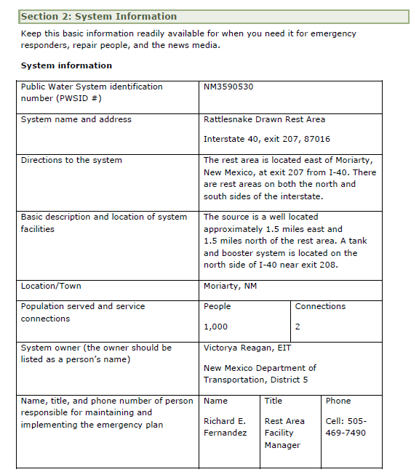
Example
Notes:
<number>

Slide 15
ERP Components
3. Chain of Command
To avoid confusion
Clearly defines lines of authority and responsibilities
Speeds up response time
Answers questions: Who to report to? Who’s in charge? Who makes decisions? What’s my responsibility?
Notes:
<number>

Slide 16
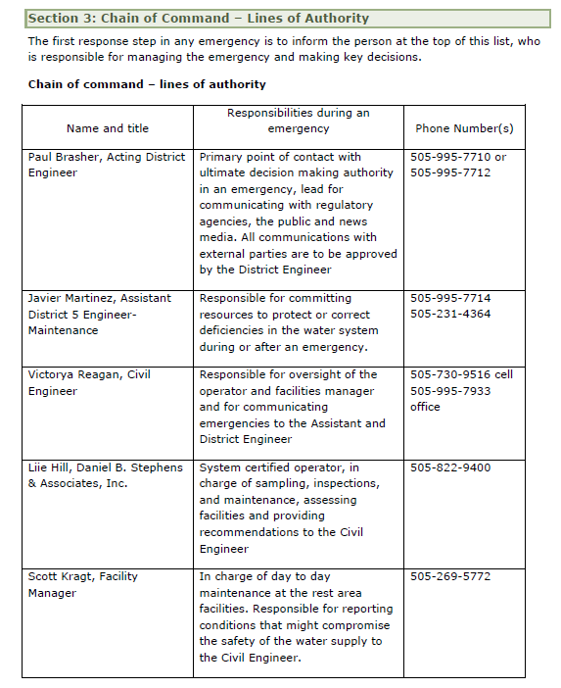
Example
Notes:
<number>

Slide 17
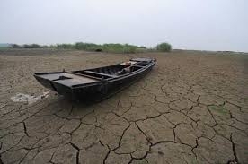
ERP Components
4. Events that cause emergencies
Natural disaster
Human error
Vandalism
System neglect
Identify these events, and associated damage
Notes:
<number>

Slide 18
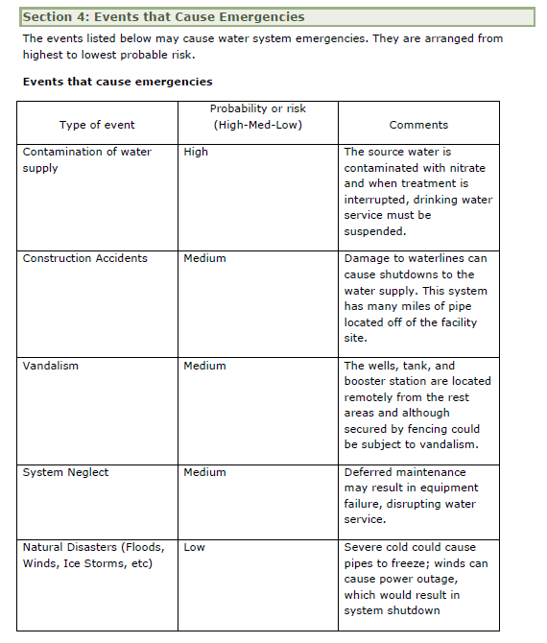
Example
Notes:
<number>

Slide 19
ERP Components
5. Severity of Emergencies
Lists and defined levels of emergency
Utilized when choosing response activities
Examples:
Level 1: line break, small power outage
Level 2: main break, initial positive E. coli, drought
Level 3: confirmed E. coli, water shortage, vandalism
Level 4: Natural disasters
Level 5: nuclear fuel spill, terrorism
Notes:
<number>

Slide 20
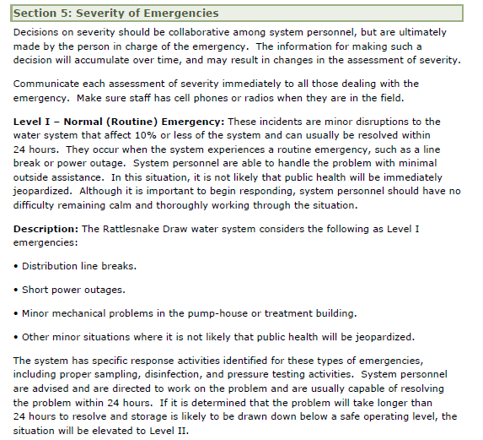
Example
Notes:
Level 1 - Normal; resolved within 24 hours
Level 2 - Alert level; resolved within 72 hours
Level 3 - Major emergency; takes longer than 3 days to resolve
Level 4 - Natural disaster; widespread causing disruption of service to more than 50% of customers
Level 5 - Nuclear or terrorism
<number>

Slide 21
ERP Components
6. Emergency Notification
Need to quickly notify a variety of parties
To do this successfully, you need:
Certain people assigned to be responsible for communication
Comprehensive call list
Procedures to quickly gather necessary information and pass it on
Phone, e-mail, media, local groups for door to door notifications
Notes:
<number>

Slide 22
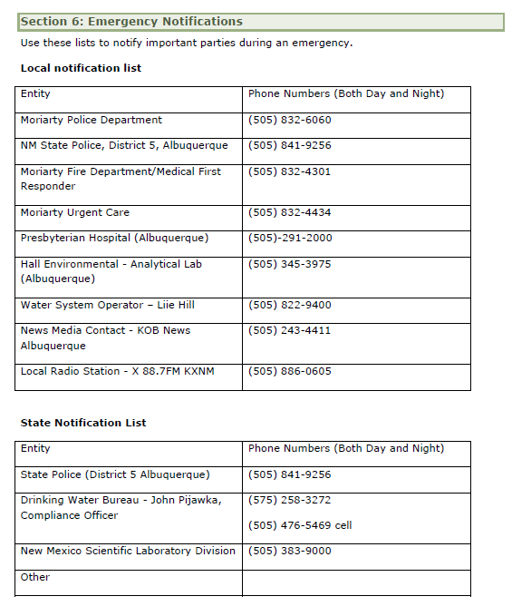
Example
Notes:
<number>

Slide 23
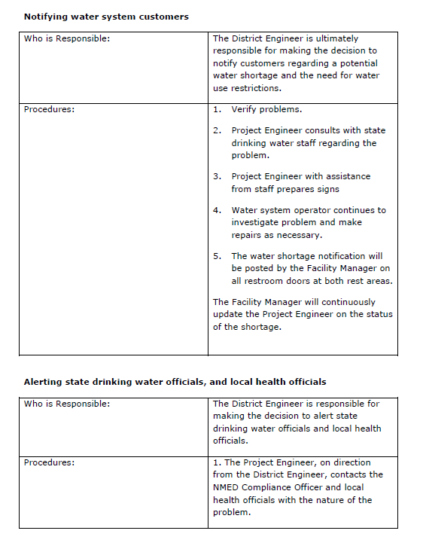
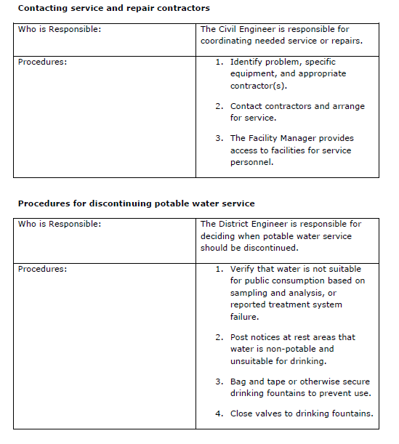
Example
Notes:
<number>

Slide 24
ERP Components
7. Water Quality Sampling
Contact DWB/issue health advisory if there’s a reason to believe that water is contaminated
Sampling and waiting for results takes time
Identify emergency sampling locations and parameters to sample
Specific to the emergency or potential contamination
Consider special sampling protocol/location/container/ preservation/labs available/turn around time/ value of the results
Include RTCR Sampling Plan
Notes:
<number>

Slide 25
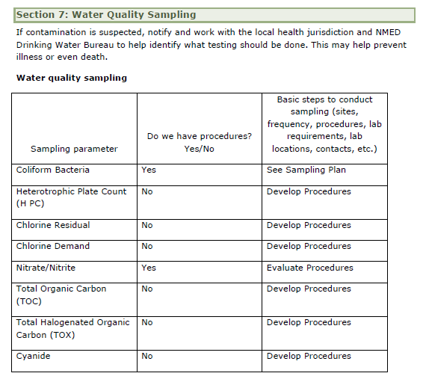
Example
Notes:
<number>

Slide 26
ERP Components
8. Effective Communication
Key element!
Be prepared to answer a lot of questions (have procedures to gather basic information)
Identify people who can answer questions
Identify and train a spokesperson to communicate to the media
Develop key messages
Develop communication protocol for field and office staff
DWB can help!
Notes:
<number>

Slide 27
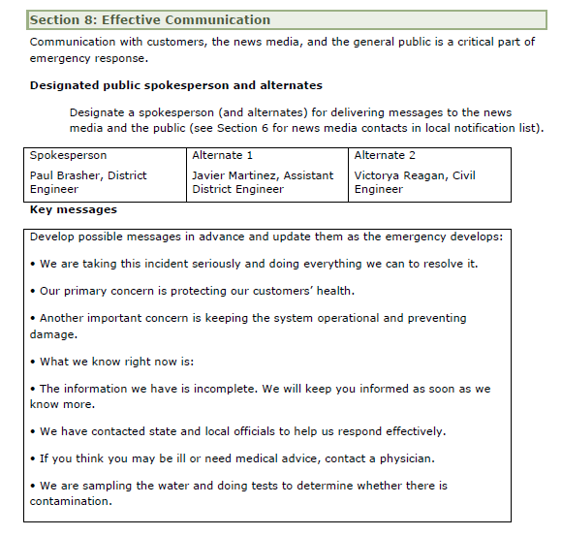
Example
Notes:
<number>

Slide 28
ERP Components
9. The Vulnerability Assessment
Required by EPA if population served >3,300 (terrorism)
List of system components with vulnerability
Vulnerability = weakness or deficiency that makes the system susceptible to damage or failure
Four parts:
Identify and map system components
Evaluate the potential and effects of potential emergency
Define expectations and set goals
Identify improvements
Notes:
<number>

Slide 29
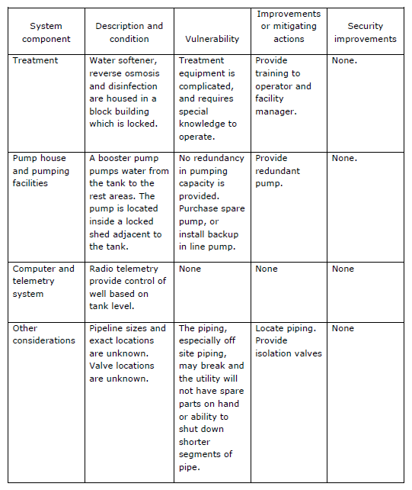
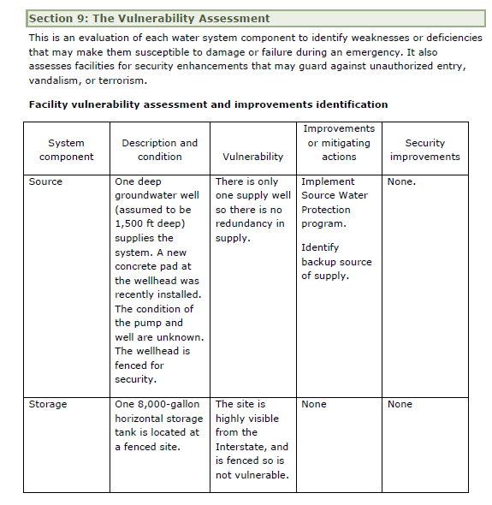
Example
Notes:
<number>

Slide 30
ERP Components
10. Response actions for specific events
Plan for each type of emergency event:
Identify type and severity of the event
Save lives!
Take action to reduce injuries and system damage
Make repairs
Return to system normal operations
Notes:
<number>

Slide 31
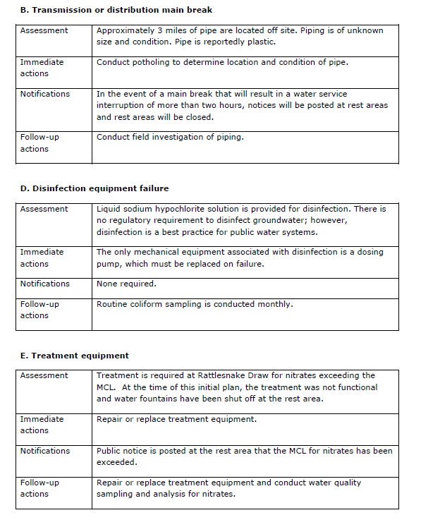
Example
Notes:
<number>

Slide 32
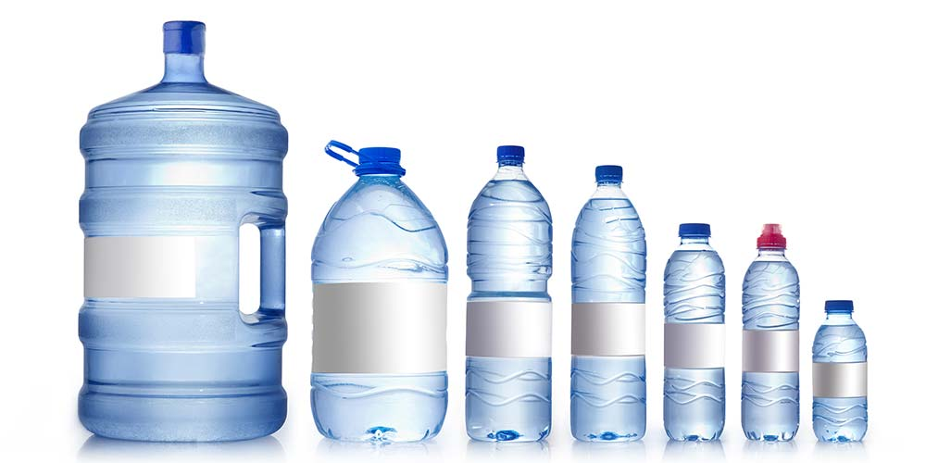
ERP Components
11. Alternative water sources
What’s your plan in case of contamination or disruption of supply?
Define emergency sources:
Nearby system?
Bottled water
Tanker trucks
Notes:
<number>

Slide 33
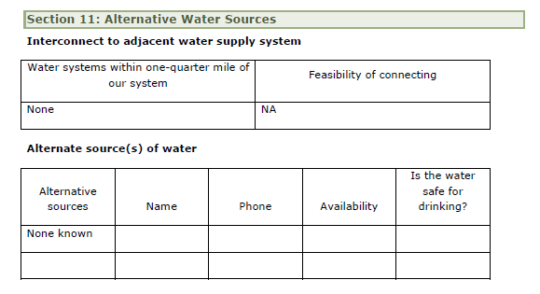
Example
Notes:
<number>

Slide 34
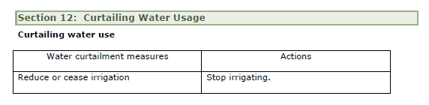
ERP Components
12. Curtailing water use
Water use reduction may be necessary. How to achieve that?
Develop methods:
Watering restrictions
Car washing
Swimming pools/hot tubs
Develop curtailment message
Formally adopt, if possible
Example
Notes:
<number>

Slide 35
ERP Components
13. Returning to normal operation
Answer the following questions:
Is the system repaired?
Is the system inspected for safety?
Is the system flushed, disinfected, pressure tested?
Can the system meet demand?
Is the water being tested? Are the tests good?
What do the regulations say? (DWB, EPA)
Has the public been properly notified?
Notes:
<number>

Slide 36
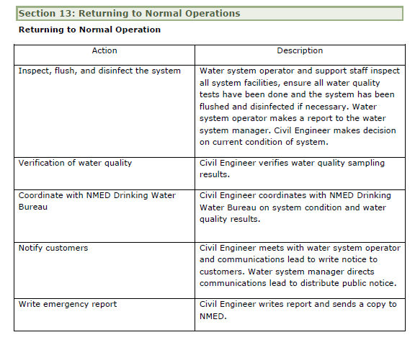
Example
Notes:
<number>

Slide 37
ERP Components
14. Training and rehearsals
Plan has no use sitting in someone’s drawer
Training is essential
Identify personnel training needs
What needs to be practiced beforehand?
First aid
Communication
Isolating parts of the system
Inspections
What to look for in a vandalism/terrorism case
Notes:
<number>

Slide 38

ERP Components
15. Plan Approval
Responsible parties should review, approve, and sign the plan
Manager
Owner
Board
Commissioners
Council members
This makes the plan official and in effect
Notes:
<number>

Slide 39
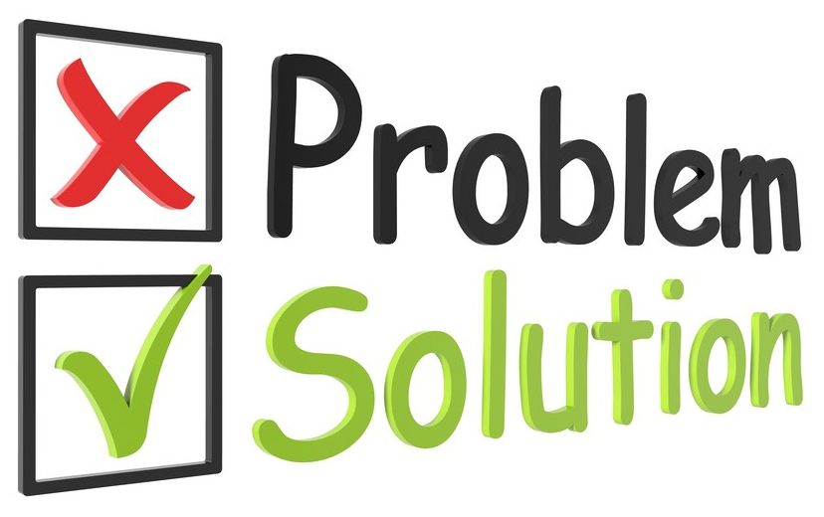
Common Development Issues
Notes:
<number>

Slide 40
Common Development Issues & Solutions
General Information
Section 1: Emergency Response Mission & Goals
Section 2: System Information
Section 3: Chain of Command – Lines of Authority
Section 4: Events that Cause Emergencies
Section 5: Severity of Emergencies
Section 6: Emergency Notification
Section 8: Effective Communication
Section 11: Alternative Water Sources
Section 12: Curtailing Water Use
Technical Sections
Section 7: Water Quality Sampling
Section 9: The Vulnerability Assessment
Section 10: Response Actions for Specific Events
Section 13: Returning to Normal Operations
Section 14: Training and Rehearsals
Notes:
Point out interchangeable information between O&M and ERP
The problem and solution with this is if the Developer is does not have technical or water system knowledge
<number>

Slide 41
Common Development Issues & Solutions
The Developer sometimes attempts to populate everything with content without logically processing how template items relate to their Utility, or just leaves the template sections blank.
Notes:
<number>

Slide 42
Section 9: The Vulnerability Assessment
System Component | Description and Condition | Vulnerability | Improvements or mitigations | Security improvements
Source | Well | Declining Water Table | Emergency Well | Physical Barrier, Inspect Daily
Storage | Storage Tank | Thermal Stratification, Short Circuiting | Mixer | Physical Barrier, Inspect Daily
Treatment | Peristaltic Pump | Line and Injector Clogs, Power Outage | Regular PM | Physical Barrier, Inspect Daily
Pump House | Building | Pest infestation | Housekeeping | Physical Barrier, Inspect Daily
Computer and Telemetry system | RTU | Wet Connections | Regular PM | Physical Barrier, Inspect Daily
Declining Water Table
Physical Barriers, Inspect Daily
Well
Emergency Well
Thermal Stratification, Short Circuiting
Physical Barriers, Inspect Daily
Storage Tank
Mixer
Line & Injector Clogs, Power Outages
Physical Barriers, Inspect Daily
Peristaltic Pump
Regular PM
Building
Harborage for Vermin
Housekeeping
RTU
Notes:
Developer thinks security.
Ask Questions first
Coordination with the Fire Department informed them of system conditions they didn’t know about.
<number>

Slide 43
Common Development Issues & Solutions
Alternative sources | Names | Phone | Availability | Is the water Safe for drinking?
Walmart 7555 N Mesa St, El Paso, TX 79912 | Bottled Water (various brands) | (915) 833-1335 | Up to 1,000-gal (1-gal jugs) Available within 24-hrs, every 2-4 days | Yes
Tanker trucks in the area available to deliver bulk water | City of Sunland Park Fire Department 1030 McNutt Rd Sunland Park, NM 88063 | (575) 589-2302 | 5,000 gal Available in > 6-hrs, indefinitely | No, Fire Trucks are not approved water haulers
Notes:
Follow-up Actions are not fully addressed by the Developer
<number>

Slide 44
Section 12: Curtailing Water Usage
Consider advising residents to ensure all spigots and faucets are closed.
If the interim water supply is small, consider advising residents not to fill their bathtubs.
Consider advising residents water is only for hygienic needs.
Consider advising residents to only flush for bowel movements.
Consider advising residents to wet themselves during showering, shut off the water while lathering, and utilize the water to rinse.
Consider advising residents to wash garments only as necessary.
Ask the system to consider shutting off water to vacant homes.
Use disposable cutlery.
Use waterless hand sanitizing liquid.
Save any gray water you use for toilet flushing of solids
Notes:
Follow-up Actions are not fully addressed by the Developer
<number>

Slide 45
Common Development Issues & Solutions
Sections 4, 5 and 10 are interrelated but the Developer does not realize they need to complement each other to create a functional plan
Section 4: Probability of an Event
Section 5: Severity Scale
Section 10: Response Actions
Notes:
Section 4: to determine likelihood of a emergency event occurrence and assign a ranking why you gave the High, Medium and Low per each event in the comments section.
<number>

Slide 46
Section 4: Probability of an Event
Type of event | Probability or risk (High-Med-Low) | Comments
Transmission or Line Breaks | Medium (4-10/ yr) | The aspects that are considered a factor are as follows: age of lines, the materials used, local geology, freeze/ thaw interaction. The aspects that are not considered a factor are as follows: water hammer, altitude, burial depth
Power Outages | Low (1-2/ yr) | The aspects that are considered a factor are as follows: accidents and operator neglect with the power provider, tree falls.
Disinfection Equipment Failure | Low (clogs ~6/ yr) | The aspects that are considered a factor are as follows: Line and injector clogs, pump failure, hose may come loose on the chlorinator.
Pump Failure | Low (1/ 2-3 yrs) | The aspects that are considered a factor are as follows: pumps have generally lasted 4 to 8 years. Water hardness may be a factor.
Notes:
Example
<number>

Slide 47
Section 5: Severity of Emergencies
Severity Level | Service & Public Health Risk | Percent of System Affected | Time Lapse of Interruption | Example
1 | Minor | ≤ 10 | ≤ 24-hrs | Valve Damage
2 | Moderate | ≤ 50 | ≤ 72-hrs | Chemical Pump Failure
3 | Major | ≥ 50 | ≥ 72-hrs | Well Outage
4 | Severe | ≥ 50 | ≥ 1-wk | Drought
5 | Catastrophic | Catastrophic | Catastrophic | Flood
Notes:
Example
Also, emphasize public health as a metric
Ask audience to give examples of each level
<number>

Slide 48
G. Microbial (coliform, E. coli) Contamination
Assessment | Low
Immediate actions | Turn off all connections to houses, and notify customers while turning off service Ensure customers have not turned service back on super chlorinate (10 ppm) flush (2.5 fps) Take residuals to ensure the affected portion of distribution water quality is back in compliance. Preferably that a BacT sample (labeled accordingly as a special sample) to be tested at CERTIFIED LAB in CITY (refer to OMP, Appendix J). Wait for result negative microbial results before returning to service. Restore service to all customers Ensure service connection meter is not running indicating an open valve within the property Preferably return service when the customer is present in this situation. Perform Level I/II Assessment. https://www.env.nm.gov/dwb/RTCR.htm
Notifications | Notify customers while shutting off service connections Notify system compliance officer Notify customer when service is returned
Follow-up actions | Monitor water quality assess issue what caused problem.
Notes:
Example
<number>

Slide 49
Section 10: Follow-up Actions
What about maintenance work orders and changing on-hand inventory tracking for asset management?
Is there notification or follow-on actions for other agencies and/ or companies?
Should you evaluate the frequency of this occurrence to determine if the O&M plan is being followed and/or if changes are needed in the system’s O&M process?
Does this indicate another vulnerability that should be included Section 9?
Do employee’s need remedial training?
Are Senior Water Rights in jeopardy?
Optimize blending of lower quality water?
Evaluate the rate structure?
Notes:
Follow-up Actions are not fully addressed by the Developer
<number>

Slide 50
Section 10: Follow-up Actions (cont’d)
Long-term infrastructure plan, PER, etc.?
Water conservation program?
Evaluating the structural integrity of surface structures before subsurface structures?
Damage to distribution lines due to shifting ground and soil liquefaction, resulting in potential water loss, water service interruptions, low pressure, contamination and sink holes and/or large pools of water throughout the service area?
Incur liability.
Evaluate security programs.
Evaluate user access.
Is the event a symptom of a greater problem?
Notes:
Follow-up Actions are not fully addressed by the Developer
<number>

Slide 51
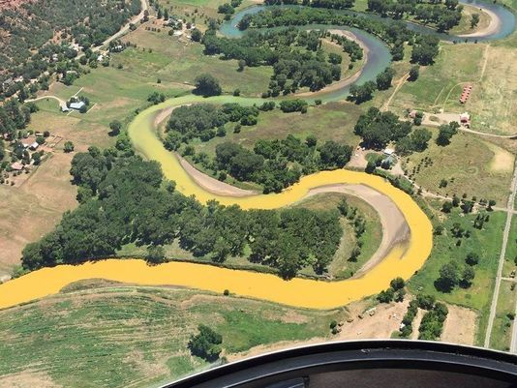
Common Development Issues & Solutions
Developer frequently dismisses emergency events as never being likely
Developer does not consider all the aspects associated with an emergency
Notes:
<number>

Slide 52
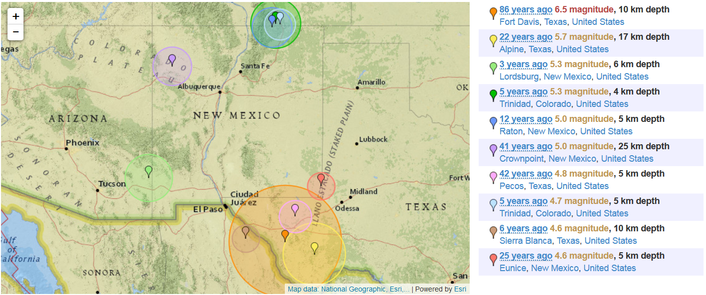
Common Development Issues & Solutions
Notes:
New Mexico has a low to moderate level of seismicity. Earthquakes larger than magnitude 6 on both the Richter and the more modern Moment Magnitude scales have occurred here in the historical past and will likely occur again. (NM Bureau of Geology & Mineral Resources)
Socorro has been the site of many earthquakes over the years. A December 1906 earthquake, with an estimated magnitude of 6.5, caused a significant amount of damage in the city.
Earthquakes during the summer of 1935 prompted many residents of Belen to spend their evenings sleeping outside out of fear that their houses would collapse, and three schools had to be closed in order to repair damage from falling plaster.
A magnitude 5.5 earthquake in 1966 caused $200,000 in damage to schools and other Bureau of Indian Affairs buildings on the Jicarilla Apache Indian Reservation.
In January 1971, an earthquake caused about $40,000 of damage to the University of Albuquerque, West Mesa High School, and several shops in the Old Town area.
In early 1989, a swarm of 34 earthquakes with magnitudes between 2.0 and 4.7 occurred near the town of Bernardo.
<number>

Slide 53
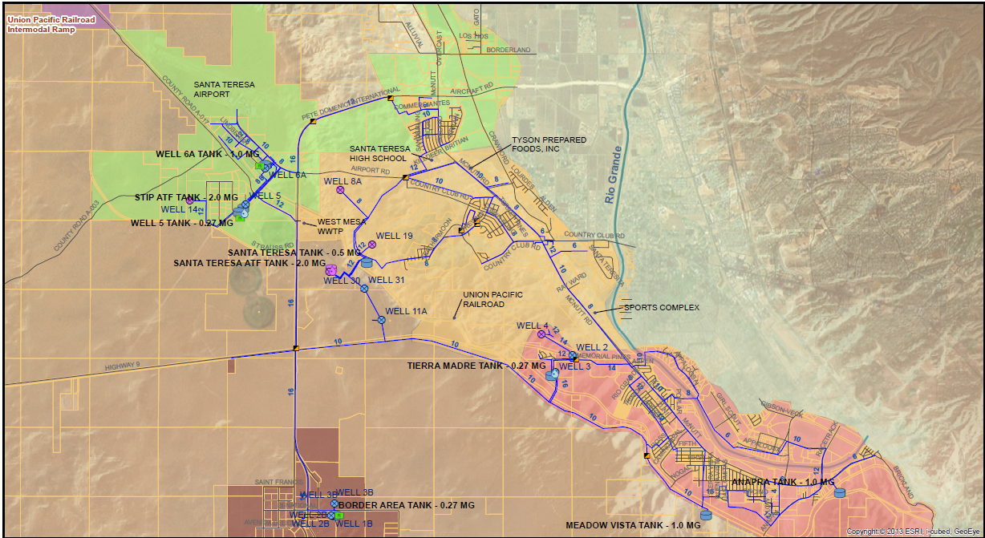
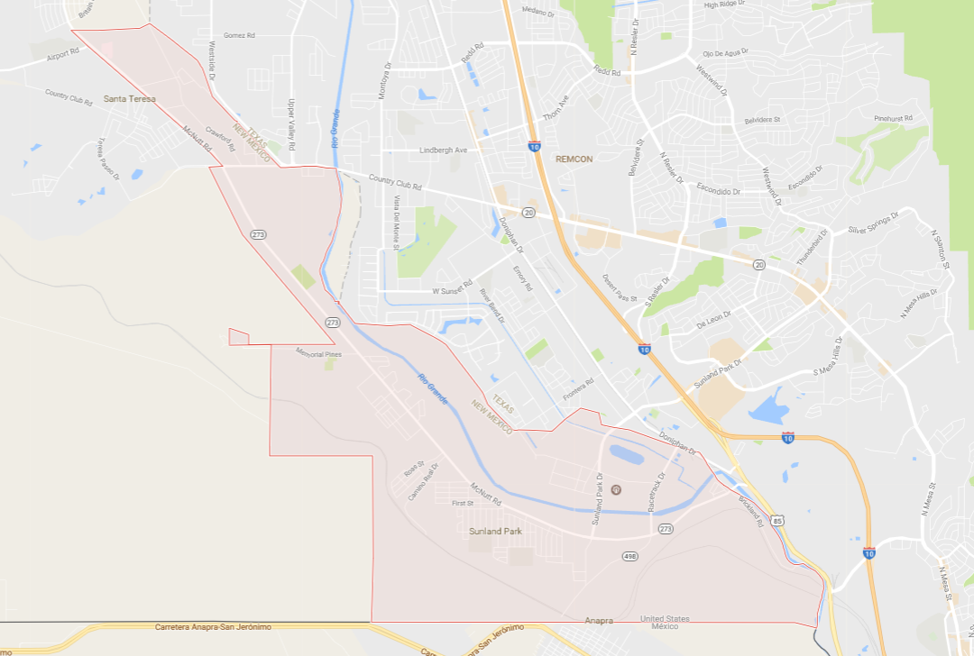
Common Development Issues & Solutions
Notes:
Unconsidered hazards:
I10 is a hazardous cargo route;
travel
vehicles stopping for rest, eating, gas, travel from industrial park or intermodal station
You may recommend they do the same type of survey as with a Contaminant inventory
You may also suggest the utility consult the local fire department, EHS professionals such as BNSF, and county EOM
<number>

Slide 54
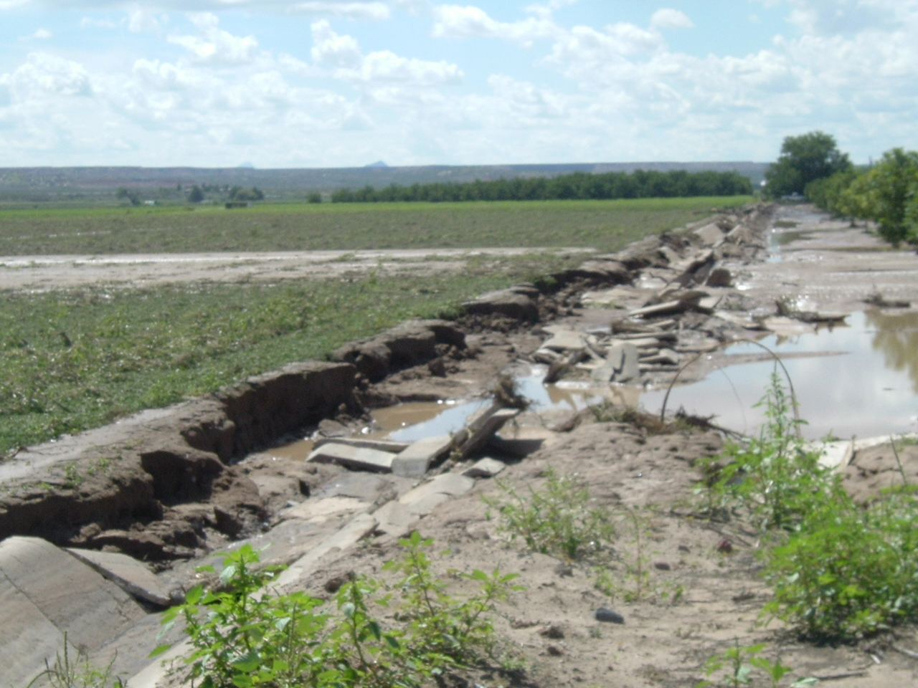
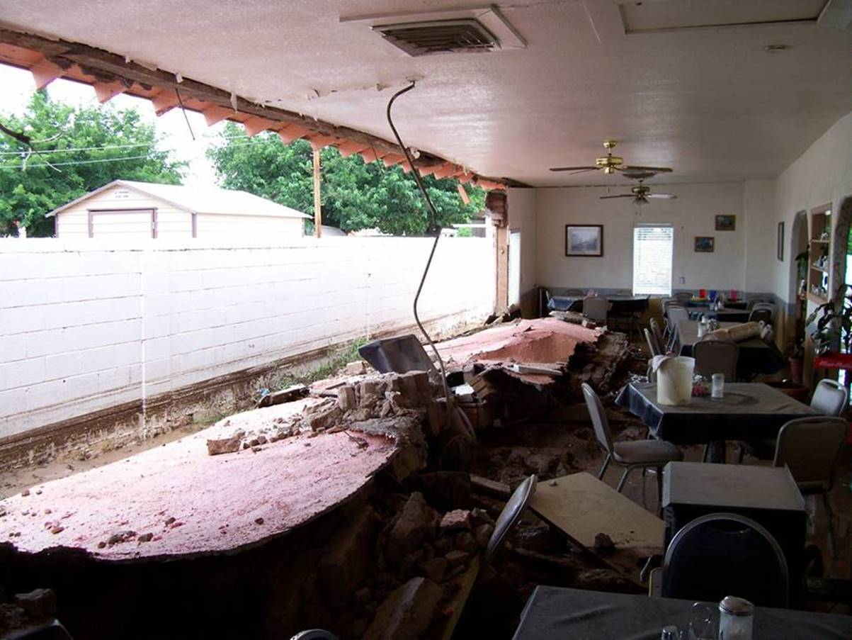
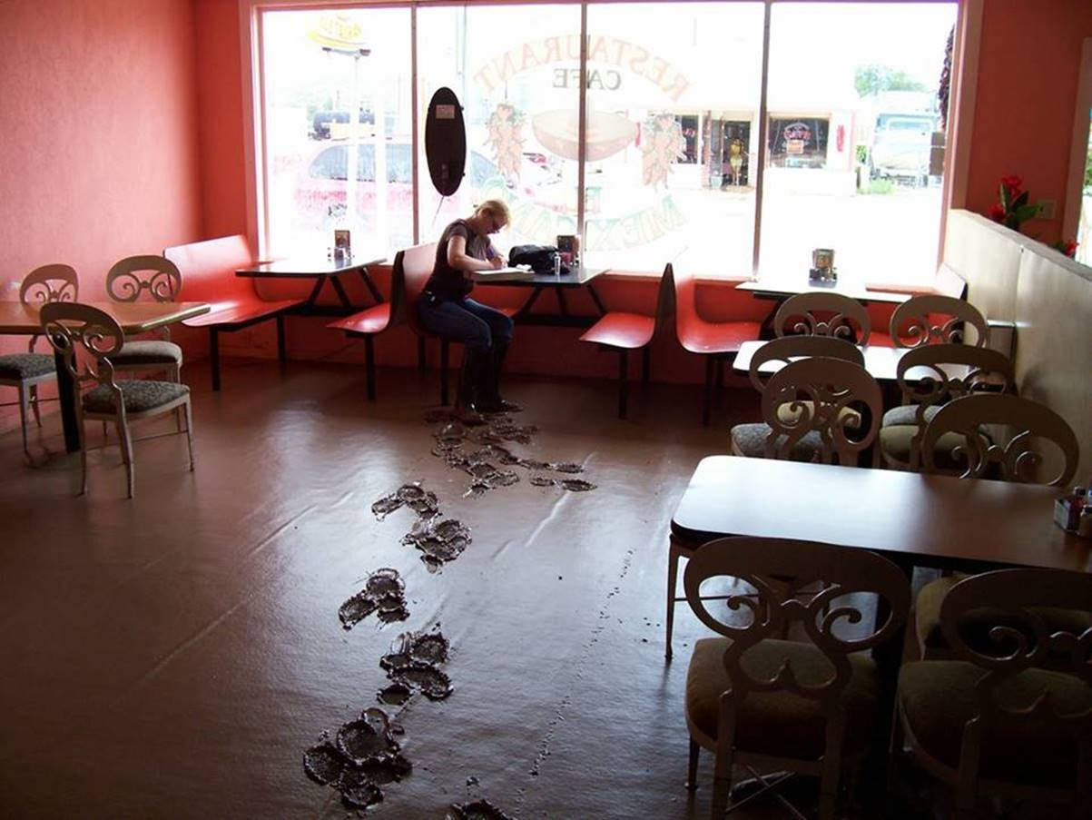
Common Development Issues & Solutions
Notes:
Flash floods, dams,
Arroyo failure *** note it is not the most commonly thought cause of flood.
<number>

Slide 55
Common Development Issues & Solutions
General Factors Not Realized by Utility When Responding to an Emergency
Record Keeping
Financial and Legal Accountability
Priority Customers
Schools, Hospitals, Nursing Homes, Daycares
MOU’s, MOA’s, NM WARN, Regionalization of Resources
Notes:
<number>

Slide 56
Operations and Maintenance Plan
Notes:
<number>

Slide 57
Operation & Maintenance Plan
Required when applying for approval from NMED for a water system project
20.7.10.200.A, 20.7.10.201.A NMAC
Helps the system define organizational structure
Describes the system and its components
Identifies SOPs, maintenance and sampling
Defines specs for new installations and repairs
Lists suppliers and contractors
Schedules maintenance activities and reports
Compiles system component O&M manuals
Notes:
<number>

Slide 58
Template
NMED Drinking Water Bureau
Applications and Forms
Operation & Maintenance Plan
https://www.env.nm.gov/drinking_water/applications-and-forms/
Notes:
<number>

Slide 60
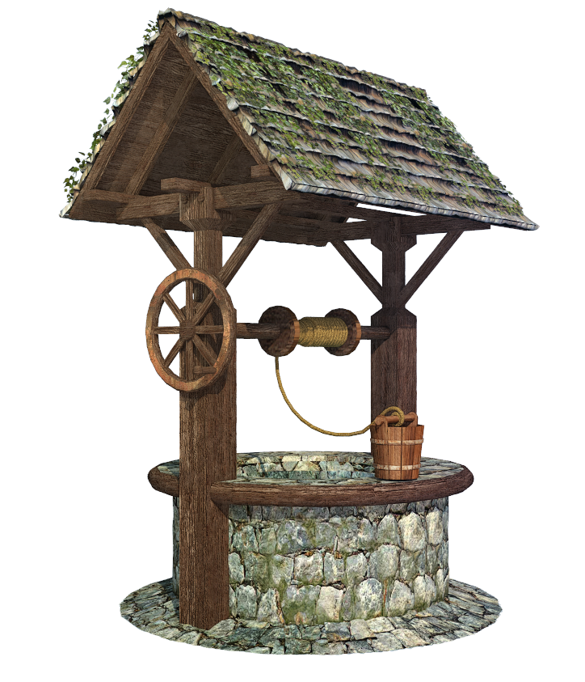
OMP Components
1. System Ownership and Designation
Name and PWS #
What type of system is it?
What’s the water source?
Notes:
<number>

Slide 61
OMP Components
2. Introduction and Overview
State the goal of your system (“to serve the public with safe potable water, maintain the system”)
State the goal of OMP
Training schedule and continuing education
When is plan updated?
Notes:
<number>

Slide 62

OMP Components
3. System organizational structure and contacts
System organizational type
Description of governing body (board, commissioners, etc.)
Contact information of all decision-makers
Notes:
<number>

Slide 63
OMP Components
4. Regulatory Agency and Regulations
Compliance officer contact
List of resources:
From the template
Local resources
Check with Joe Martinez | Northern Region Compliance Supervisor | Santa Fe | 505-476-8635
Brandi Garcia | Southern Region Compliance Supervisor | Las Cruces | 575-915-1113
Notes:
<number>

Slide 64
OMP Components
5. General system description
Background
Water Sources
Distribution system
Treatment/disinfection
Storage
Include maps
Notes:
<number>

Slide 65
OMP Components
6. System operation and control
Start-up and shutdown procedures
Emergency procedures
Troubleshooting
Operation and Control (SCADA)
Include all system components
List of daily, weekly, monthly, annual tasks (table)
Create logs to record operator activities
Notes:
<number>

Slide 66

OMP Components
7. Testing, recordkeeping, and recording
Reference distribution system sampling plan (DSSP)
Any other sampling?
List of records kept; where they are found?
Sanitary survey item
5 yrs micro, 10 yrs chem, 12 yrs lead/copper
Notes:
<number>

Slide 67

OMP Components
8. Maintenance
Table for preventative maintenance tasks based on manufacturer’s recommendations and operator experience
List of contractors
Repair/service protocol, NSF specs
Notes:
<number>

Slide 68
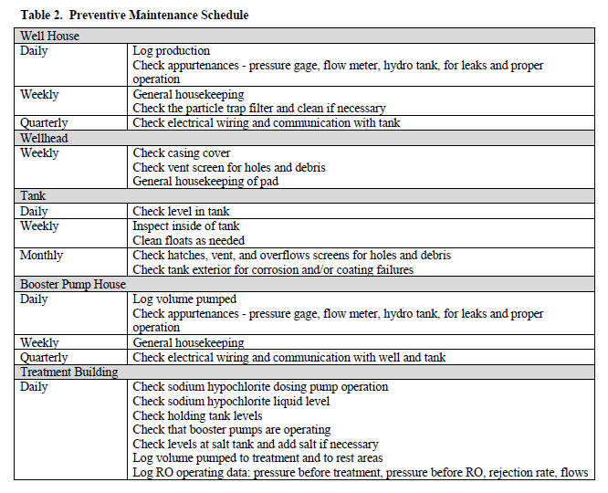
Example
Notes:
<number>

Slide 69
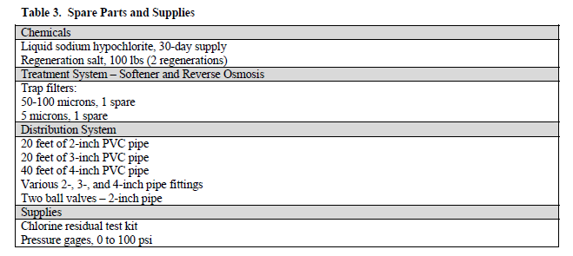
OMP Components
9. Spare parts, supplies, chemicals
List of spare parts with quantities
Notes:
<number>

Slide 70

OMP Components
10. Safety
Table to include PPE required for each task
Safety SOPs
Reference to OSHA regulations
Notes:
<number>

Slide 71

OMP Components
11. Emergency preparedness and response
Community public water systems – ERP
NM WARN
Notes:
<number>

Slide 72
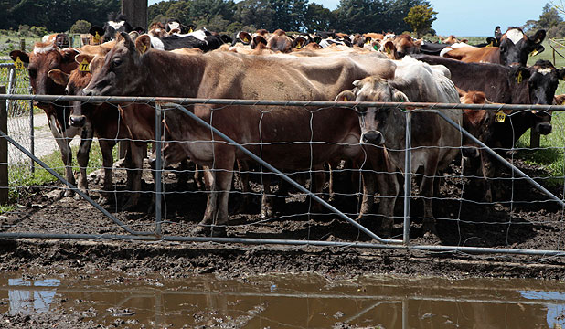
OMP Components
12. Source Water/Wellhead Protection Plan
Indicate if you have one, currency, appendix
Notes:
<number>

Slide 73
Appendices
Job duties
Operator certificates and contracts
NMED regulations
Site map
System control logs
OSE documents
Water purchase/sales agreements
Equipment data and drawings
Manufacturer’s O&M manuals
DSSP
Testing, recordkeeping, and recording templates
Maintenance tracking forms
List of manufacturers, reps, suppliers
Safety/OSHA regulations
ERP
Source Water Protection Plan
Notes:
<number>

Slide 74
Common Development Issues & Solutions
The Developer lacks the technical and managerial knowledge of the water system which the OMP is being developed for to create a functional document
Notes:
Point out that it in of itself is an educational process.
<number>

Slide 75
Common Development Issues & Solutions
General Information
Table of contents
Section 1: System Ownership and Designations
Section 2: Introduction and Overview
Section 3: System Organizational Structure and Contacts
Section 4: Regulatory Agency(s) and Regulation
Section 10: Safety
Appendices
Technical Sections
Section 5: General System Description
Section 6: System Operation and Control
Section 7: testing, recordkeeping and reporting
Section 8: Maintenance
Section 9: Spare Parts, Supplies and Chemicals
Notes:
Point out that it in of itself is an educational process.
<number>

Slide 76

Common Development Issues & Solutions
The Developer does not know how to populate Section 10 – Safety.
Developer simply states the Utility follows all OSHA regulations
Developer does not reference safety consideration for specific tasks
Chlorine – PPE, SDS’s, etc
Tank Inspection – Confined Area
Developer leaves the Section blank
Notes:
<number>

Slide 77

Common Development Issues & Solutions
Developer does not realize that the completeness checklist for the OMP is in the instructions
Developer misunderstands the section examples and either misrepresents their system by building on them or leaves them in the plan untouched
Notes:
<number>

Slide 78
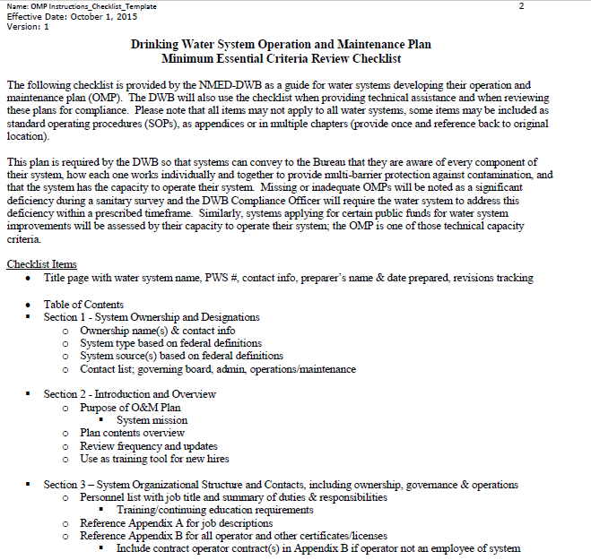
Common Development Issues & Solutions
Notes:
Make note of the checklist items for Developer
Also, note that the form metadata can be removed.
<number>

Slide 79
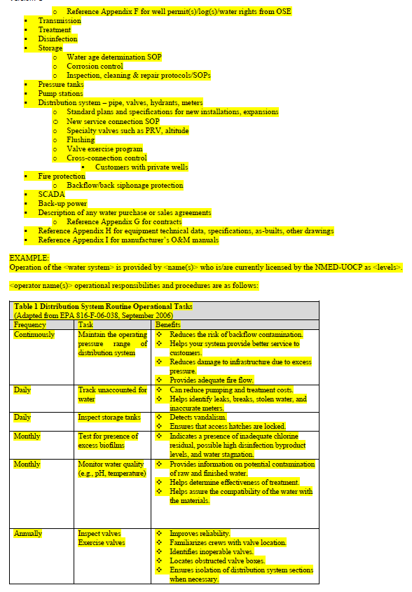
Common Development Issues & Solutions
Notes:
These are provided as examples but do not necessarily need to be in this format and every example presented may not be applicable to each Utility
<number>

Slide 80
Common Development Issues & Solutions
Developer does not know how to develop Sections 6 & 8 (Operator Sections) due to formatting, technological literacy or lack of water system knowledge
Notes:
<number>

Slide 81
Common Development Issues & Solutions
Developer has difficulty differentiating between Water System tasks Section 6 and 8 tasks:
Operation & Control Tasks (Section 6)
Maintenance Tasks (Section 8)
Notes:
<number>

Slide 82
Potential Operations & Control Tasks
Complete Security Checks | Continuously
Check Chemical Supply Levels and Record Usage | Daily
Record Water Levels in Storage Tanks | Daily
Check and Record Water Levels in Pressure Tanks | Daily
Inspect Chemical Feed Pumps for Proper Operation | Daily
Check and Record Chlorine Residuals at Entry Point | Daily
Record Well Run Time and Pump Cycle Starts | Daily
Check Water Meter Readings and Record Water Production. | Daily
Record other daily chemical Solution Usage | Daily
Check and Record Chlorine Residuals in Distribution | Daily to Weekly
Inspect Booster Pump Stations | Daily to Weekly
Check Fluoride Concentration in Distribution | Daily to Weekly
Check Instrumentation for Proper Input/ Output | Daily to Weekly
Check and Record Fluoride Concentration in the Distribution System | Daily to Weekly
Check and Record Static and Pumping Levels of Each Well | Monthly
Begin Safety Equipment Repair Log Card | Monthly
Customer Meter Reading | Bi-Annually
Flushing Program | Annual Rotation
Backflow Prevention Program | Annual Rotation
Water Loss/ Leak Detection Program | Annually to Triennially
Review Emergency Response Plan | Annually to Triennially
Notes:
This a just a list to help them think about what tasks they actually do. If they do perform a task then they should include it in the plan
<number>

Slide 83
Common Development Issues & Solutions, Section 8
Potential Maintenance Tasks
Investigate Customer Complaints | As Needed
Maintain a Log of Water Line Repairs | As needed
Record Pumping Rate for each Well or Source Water Pump | Daily
Inspect Heater Operation | Daily to Weekly
Clean Pump House and Grounds | Weekly to Monthly
Ensure Fire Hydrants Are Accessible | Weekly to Monthly
Inspect Storage Tanks | Weekly to Monthly
Clean Storage Tank Grounds | Weekly to Monthly
Operate all Valves Inside the Treatment Plant and Pump House | Monthly
Inspect, Clean, and Repair Control Panels in Pump House and Treatment Plant | Monthly
Calibrate Chemical Feed Pumps after Overhaul | Every 3-Months
Inspect Testing Equipment | Every 3-Months
Inspect and Clean Chemical Feed Lines and Solution Tanks | Every 3-Months
Valve Exercising Program | Annual Rotation of Distribution
Flush the Distribution System and exercise/ Check Fire Hydrant Valves | Annual Rotation of Distribution
Prepare for Season Operation Differences | Annually
Inspect and Clean the Chemical Solution Tanks | Annually
Have Electrician Check the Running Amps on Well Pumps | Annually
Overhaul Electrical Feed Pumps | Annually to triennially
Notes:
There may be some overlap
<number>

Slide 84
Common Development Issues & Solutions
Developer thinks that it is mandatory to incorporate entire large documents such as:
Drinking Water Regulations (Appendix C)
Manufacturer’s O&M Manuals (Appendix I)
NMED-DWB DSSP (Appendix K)
Emergency Response Plan (Appendix O)
Source Water/ Wellhead Protection Plan (Appendix P)
Notes:
They may if they wish but they may also give instruction on the location and how to access them.
Included lists w/ dates on the O&M
Include special notes regarding each or pertinent excerpts
<number>

Slide 85
Common Development Issues & Solutions
There is some redundancy within all of these plans
Facilitates each plan’s individual functionality
Material from one plan may be used in another plan when developing these plans
Facilitates each plan’s association with the others and helps to demonstrated the interconnectivity of each plan’s purpose to real-world operations
Intended to bridge the knowing-doing gap
Notes:
<number>

Slide 86
Interchangeable Material When Developing Plans
OMP
Section 2: Introduction and Overview
ERP
Section 1: Emergency Response Mission & Goals
OMP
Section 2: System Information
Section 5: General System Description
ERP
Section 2: System Information
OMP
Section 7: testing, recordkeeping and reporting
ERP
Section 7: Water Quality Sampling
DSSP (OMP, Appendix J)
OMP
Section 1: System Ownership and Designations
Section 3: System Organizational Structure and Contacts
ERP
Section 3: Chain of Command - Lines of Authority
Notes:
<number>

Slide 87
Interrelated Material When Developing Plans
OMP
Section 9: Spare Parts, Supplies and Chemicals
Section 10: Safety
ERP
Section 10: Response Actions for Specific Events
OMP
Section 6: System Operation and Control
Section 7: testing, recordkeeping and reporting
ERP
Section 13: Returning to Normal Operations
Section 14: Training and Rehearsals
DSSP (OMP, Appendix J)
ERP
Section 6: Emergency Notification
Section 8: Effective Communication
Section 12: Curtailing Water Use
Section 11: Alternative Water Sources
OMP
Section 4: Regulatory Agency(s) and Regulation
DSSP (OMP, Appendix J)
OMP
Section 8: Maintenance
Section 9: Spare Parts, Supplies and Chemicals
ERP
Section 9: The Vulnerability Assessment
Section 4: Events that Cause Emergencies
Notes:
<number>

Slide 88
Useful links
Drinking Water Watch
https://dww.water.net.env.nm.gov/NMDWW/
SEP Database
https://sep.net.env.nm.gov/sep/login-form
New Mexico Office of the State Engineer
www.ose.state.nm.us
Notes:
<number>

Slide 89
Distribution System Sampling Plan
Notes:
<number>

Slide 90
Template
NMED Drinking Water Bureau
Applications and Forms
Distribution System Sampling Plan
https://www.env.nm.gov/drinking_water/applications-and-forms/
Notes:
<number>

Slide 92
Distribution System Sampling Plan
Required by DWB
Has to be approved by DWB
Uses an NMED Template
Has to be specific!
An appendix to OMP
Notes:
<number>

Slide 93
DSSP Outline
Written description of your system
MAPS!
general layout
system components
sampling sites
Written description of each sampling site
Where to take the sample?
Review and approval by DWB
Notes:
<number>

Slide 94

It’s a living document
DSSP needs to be updated when:
regulations change
population changes (puts your system to a different bracket)
water source changes
infrastructure changes (incl pressure zones, extended lines, storage, treatment)
Notes:
<number>

Slide 95
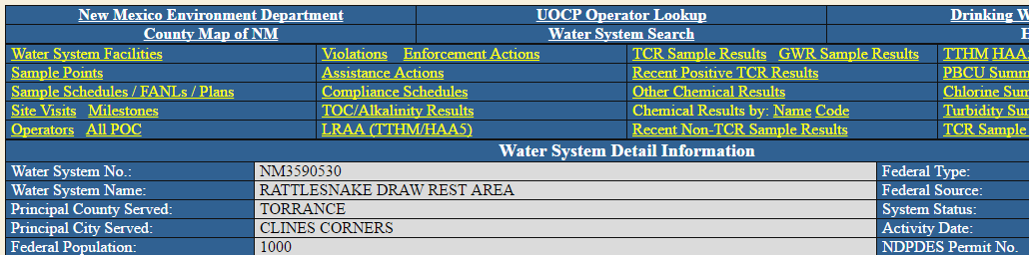
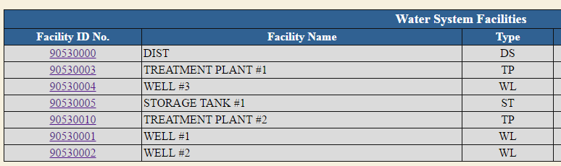
Drinking Water Watch
Notes:
<number>

Slide 96
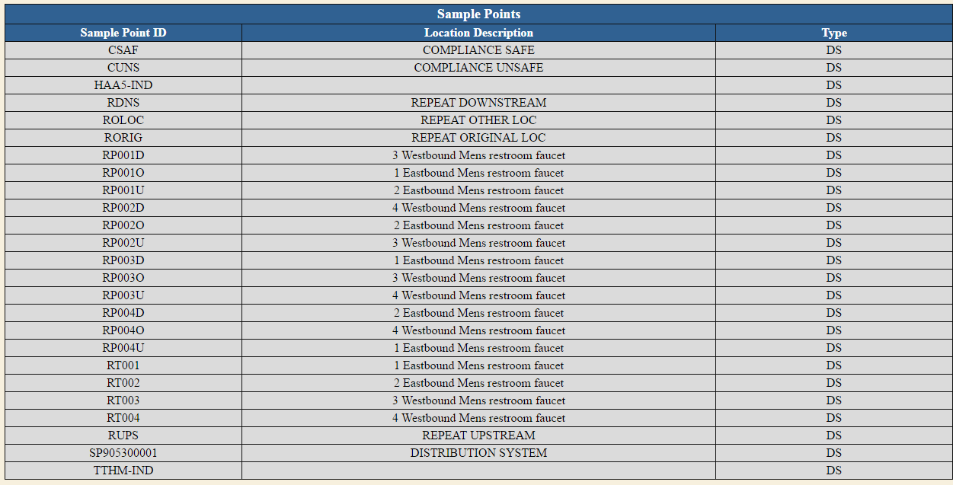
Sample Point ID
Notes:
<number>

Slide 97
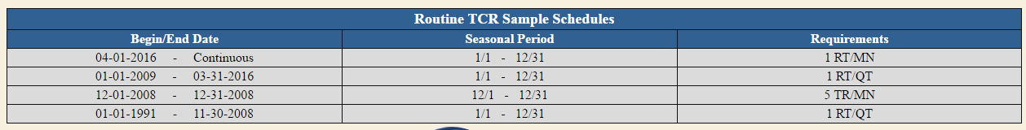
Sample Schedules
Basic info on Drinking Water Watch (DWW):
More details and sample tracking available through Secure Extranet Portal (SEP) on the Drinking Water Sample Collection Tool application
Notes:
Log on and show the tool
<number>

Slide 98
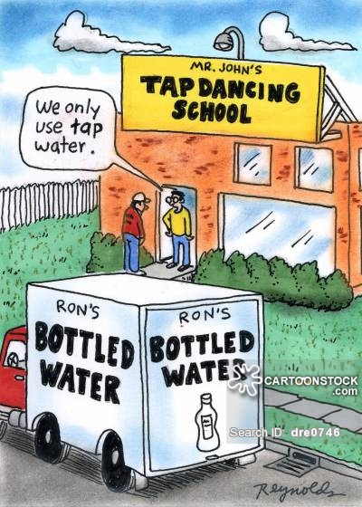
What kind of sampling is included?
Bacteriological - RTCR
Chlorine Residual
Lead and Copper - LCR
Disinfectants/ Disinfection By-Products - D/DBP
Asbestos
Turbidity
Notes:
<number>

Slide 99
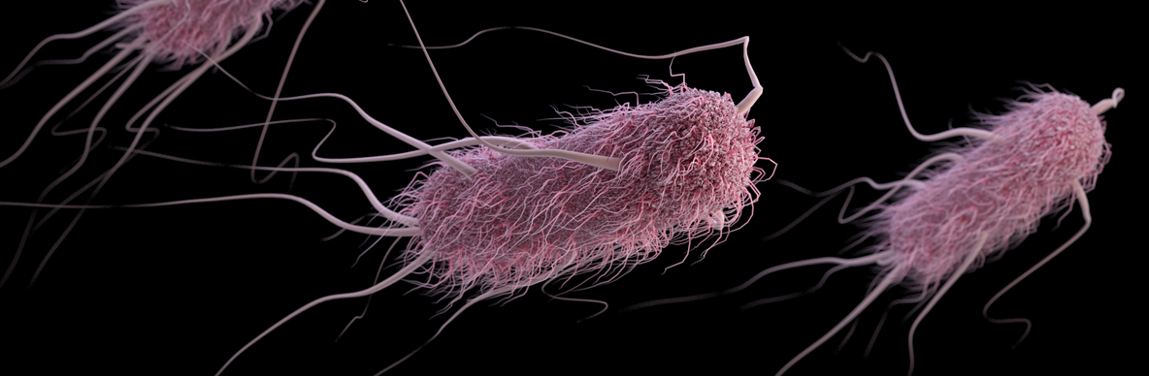
Revised Total Coliform Rule
Sampling under RTCR is required by all systems
Monthly sampling
Specifics covered in a separate class
Notes:
<number>

Slide 100
Chlorine Residual Monitoring
Best Management Practice
MRDL - 4mg/L
maintain residual
meet chlorine demand
DBP control
Residual Chlorine + Water Age = DBPs!
TOC is a precursor!!
SW: TOC from the source
GW: COD, biofilm in tanks and lines, HPC
Required minimum number of monthly monitoring sites corresponds with RTCR and RTCR multiplier
Never just measure when sampling for RTCR!
Notes:
<number>

Slide 101
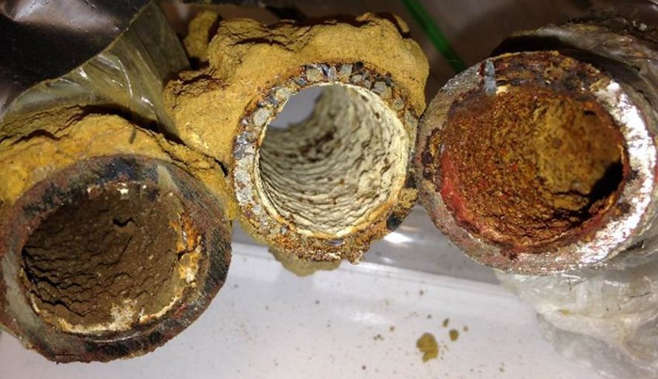
Lead and Copper Rule
Required for all community and NTNC water systems
Number of samples based on population served, see DWW, or Sampling Tool
No MCL - action level:
Pb = 0.015mg/L,
Cu = 1.3mg/L
Corrosion Control
Notes:
<number>

Slide 102
LCR Sampling Locations
LCR TIER STRUCTURE
Community (CWS) |  | Non Transient Non-Community (NTNCWS)
Structures that have copper pipes with lead solder or lead pipes and/or served by lead service lines
Tier 1 | single family structures installed 1983 through 1985; or multi-family structures (1983-1985) that make up > 20% of total service connections | Tier 1 | any structure installed from 1983 through 1985
Tier 2 | multi-family structures installed by 1983 and after that make up 20% or less of total service connections | Tier 2 | N/A
Tier 3 | single family structures installed by 1982 or before | Tier 3 | any structure installed by 1982 or before
Other | structures with other plumbing materials | Other | structures with other plumbing materials
Notes:
Use the Tiers to decide where to take the lead and copper samples.
<number>

Slide 103
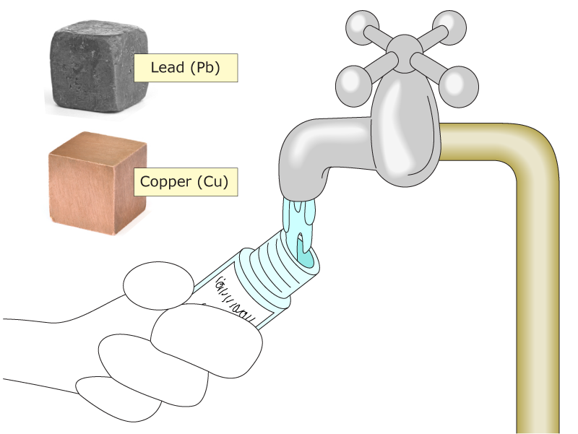
LCR Sampling Procedure:
Collected from a customer’s tap
“First draw”
6-18 hours of water age in customer’s plumbing
Collected by customer
Collected during warm weather (July - Sept)
Notes:
<number>

Slide 104
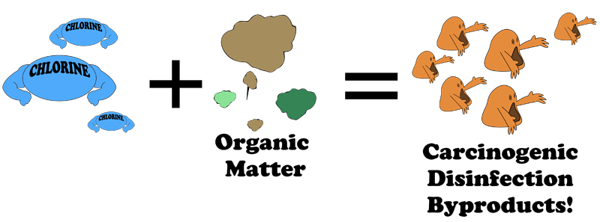
Disinfection Byproducts
Applies to all community and NTNC water systems that disinfect (UV excluded), and TNC water systems that add Chlorine Dioxide
Sample the “oldest water” in your system
DBP formation influenced by pH and temperature:
Sample in the Summer (if required one sample per year)
Notes:
<number>

Slide 105
D/DBP Sampling
Serving under 500:
One sample for TTHM-IND and one sample for HAA5-IND
GW system serving 500 - 9999
Annual dual sample for TTHM and HAA5
SW system serving 500 - 3300
quarterly TTHM-IND and HAA5-IND
SW system serving 3301 - 9999
Quarterly dual sample for TTHM and HAA5
Notes:
Certain systems can get both annual samples from the same location
<number>

Slide 106
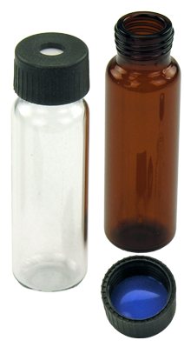
D/DBP Sampling
All other systems:
Based on system size
Anywhere from 4 to 20 samples for TTHM and HAA5 each quarter
TTHM samples must be collected without any “headspace” or bubbles.
Notes:
Certain systems can get both annual samples from the same location
<number>

Slide 107
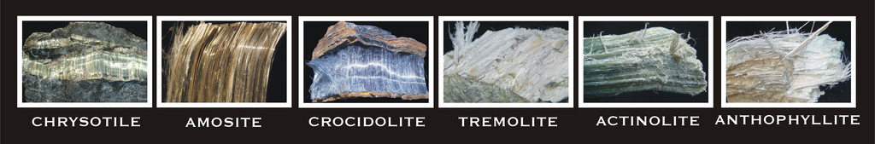
Asbestos
Required to sample if:
system is using AC piping
potential asbestos contamination in the source water
Sampling from a commonly used tap
Talk to your CO about historic asbestos sampling results
Notes:
<number>

Slide 108
Turbidity
Turbidity is the measurement of cloudiness
Originates from clay, silt, mud, organic matter
Not a health risk, but can shield pathogens
Applies to surface water and ground water under the influence of surface water - must provide treatment to meet MCL.
See sample schedule in DWW or Sampling Tool
Notes:
<number>

Slide 109
EPA Surface Water Treatment Rules
Turbidity is regulated in:
First SWTR – 1989
Interim Enhanced SWRT – 1998 (≥10,000)
Long Term 1 Enhanced SWTR – 2002 (<10,000)
Combined Filter Effluent - ≤0.3 NTU – 95%
CFE Maximum – 1 NTU
Individual Filter Effluent – monitor
Measured at the plant, not DS

Slide 110
For More Information, Contact:
Joe Martinez PWSS Group Manager 505-476-8635 joe.martinez@state.nm.us Danielle Shuryn SWIG Manager 505-476-8637 danielle.shuryn@state.nm.us
Notes:
<number>

Slide 111

Questions?
Notes:
<number>

Slide 112
Notes:
<number>

