Slide 1
Distribution System Maintenance
Notes:
Introductions

Slide 2
Outline
Distribution system components
Line repairs
Valves, hydrants, service lines, water meters
Corrosion
Maintenance
Asset management
Water loss and leak detection
Cross-connections
Notes:
6 hour training, 6 credits, an hour for lunch
Group activity – What distribution system issues are you aware of that may have impacted public health? Write down issues and group them together. Groups report out on the 3 most common issues.

Slide 3
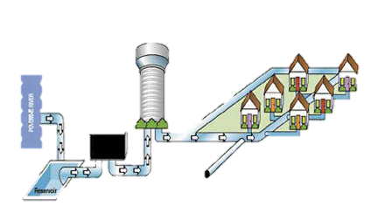
Distribution System
The link between the water source and the customer/consumer

Slide 4
Distribution system components

Slide 5
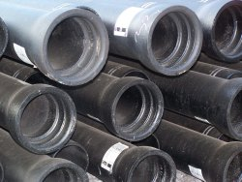
Types of Pipes
Cast iron (CIP) and ductile iron pipe (DIP)
Strength, load bearing capacity
DIP stronger, less rigid than gray CIP
Both brittle, inflexible
Heavy, subject to corrosion
CIP less resistant to corrosion than DIP
3- to 54-inch-diameter, 18- to 20-foot lengths
Flanged joints above ground, bell/spigot and mechanical joints below ground
Service taps either directly tapping (difficult!) or saddles

Slide 6
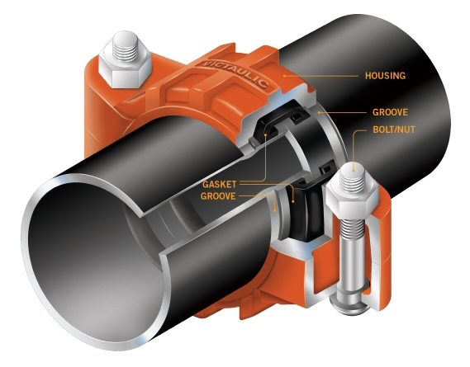
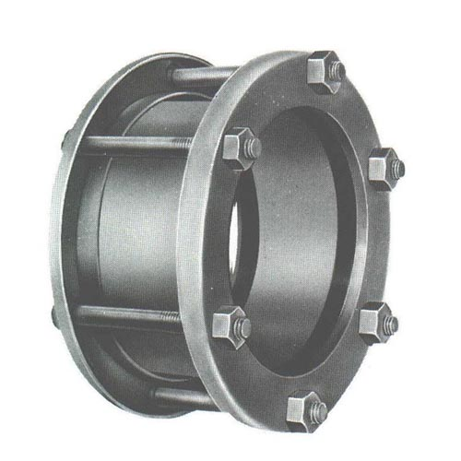
Types of Pipes (continued)
Steel
NSF or AWWA C-200 standard
Schedule 40 and Schedule 80
Lighter, easier to handle, more flexible than IP
Very susceptible to corrosion
Lower bearing strength, collapse under vacuum
Joining: threaded coupling, welded coupling, Dresser or Victaulic coupling, flanges, rubber ring push-on
Notes:
Comes in 1/8 to 36 inches, 21ft lenghts
Upper (Vitaulic) lower (Dresser)

Slide 7
Types of Pipes (continued)
Asbestos-Cement Pipe (ACP)
  Less expensive, lighter, easier to install and tap than IP
  Resists corrosion and tuberculation
  Joined using sleeved couplings and O-rings
  Health hazard (carcinogenic)
  Brittle, cracks under trench loads, difficult to repair
  Repairs with C-900 PVC
Plastic (PVC, HDPE)
  Light, easy to install and repair
  Unaffected by corrosion
  Susceptible to thermal expansion (lengthwise)
  Fragile – select backfill material
Notes:
Asbestos = Transite (commercial name)
3-36 inches, 13 ft lengths + short sections
Use CI fittings and valves, not made anymore.
Plastic: Both PVC and HDPE have the same OD as CI, PVC can be used to repair CI.
PVC- Bell and spigot joints (lubricate and push in), 1/2 - 16 inch, 20 ft lengths
HDPE - heat fused, stainless steel insert, stainless steel adapters for vitaulic, flanged. up to 3 inch in a roll, larger sizes (up to 16 in) 20 and 40 ft lengths.
HDPE is pressure rated up to 220 psi

Slide 8
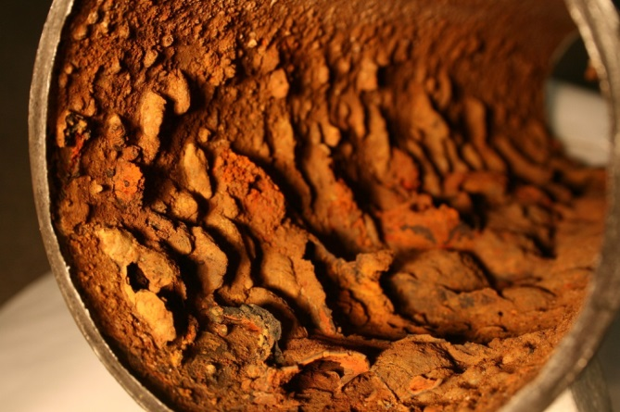
Corrosion
Attacks metal components of distribution system
  Causes rust; increases friction loss
  Can cause Pb, Cu problems (brass 7-11% Pb)
  Dissolved Cl, CO2 or DO; low pH, alkalinity can cause corrosion
Determining corrosion potential
  Langelier Index based on lab data
  temp, TDS, Ca and alkalinity
  online calculator
https://www.cleanwaterstore.com/technical/water-treatment-calculations/share-calculater/langlier.php

Slide 9
Other Types of Corrosion
Galvanic
  2 dissimilar metals in contact with each other
  Submerged in water
    Generates electric current between metals
  Plating leads to metal failure
  Meter installations, service connections

Slide 10
Other Types of Corrosion (cont.)
Electrolysis
  DC current through metal pipes
  Discharges to ground
  Metal plates from pipe to ground – failure point
Corrosive (acidic) soil
  External corrosion potential
  Need to coat CIP and DIP

Slide 11
Cathodic Protection
cathodic protection - the prevention of electrolytic corrosion in something metallic such as an underground pipe or a ship by making it the cathode in an electrolytic cell
Which components do you think might need cathodic protection?

Slide 12
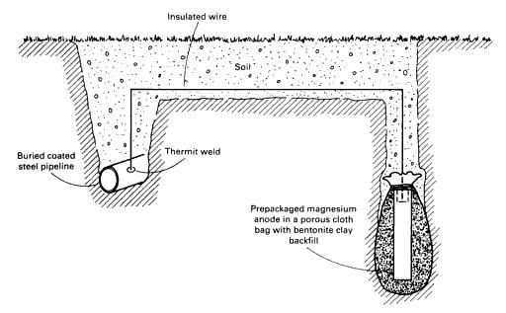
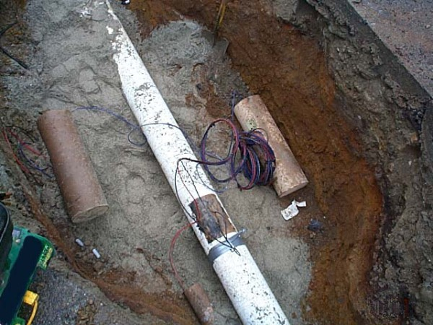
Sacrificial Anode

Slide 13
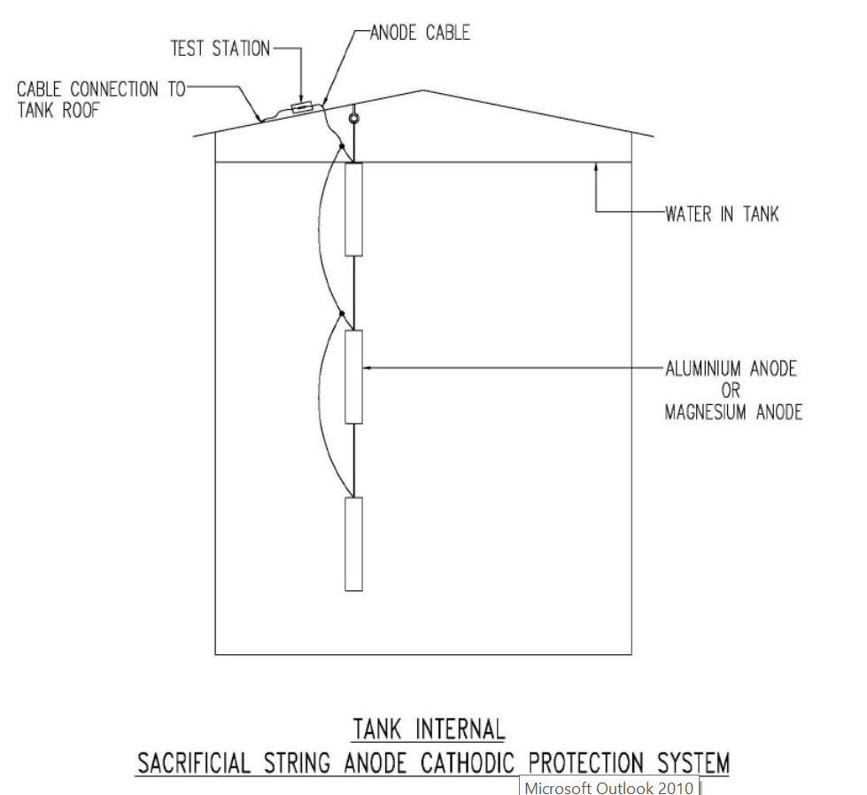
Tank Corrosion Protection

Slide 14
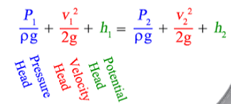
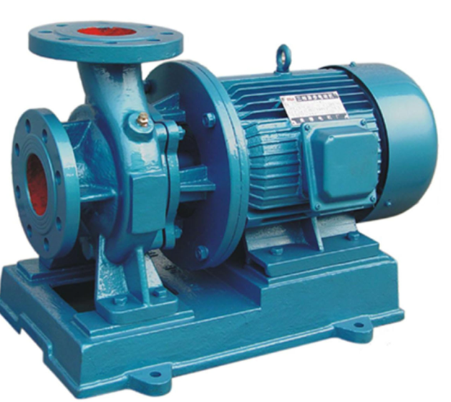
System Hydraulics
Friction loss
  Loss of energy – Bernoulli equation
  Factors
    Pipe length, diameter
    Flow rate
    “C” factor – coefficient of friction
Water hammer or pressure surge
  Due to quickly stopping pipe flow
  The faster the stop, the bigger the surge
  Rupture lines, lift hydrants
  Open & close valves slowly (pump control valves)
  Use thrust blocks
Notes:
Hammer can be 120 psi above system pressure.

Slide 15
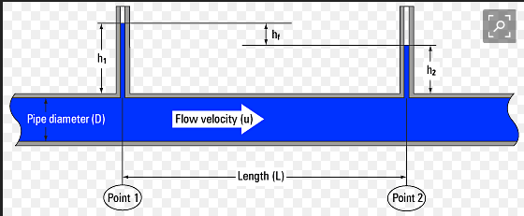
Friction Loss in Pipe
Proportional to Flow and Inside Diameter
Dia (in) | Flow (gpm) | HL (ft/100 ft)
3 | 500 | 73.6
4 | 500 | 16.4
6 | 500 | 5.67
Notes:
This is why fire hydrants have to be on a minimum 6-inch pipe.

Slide 16
System Hydraulics (continued)
Thrust blocks
  Prevent joint leakage
  Bends, elbows, tees, dead-ends
  Thrust factors
    Bend angle
    Pipe diameter
    Internal pressure
    Use 1.5:2 safety factor multiplier to account for surges
  Size of block depends on surrounding soil type
    Hard clay can support up to 9000 #/ft2
    Soft clay can support up to ~ 1000 #/ft2

Slide 17
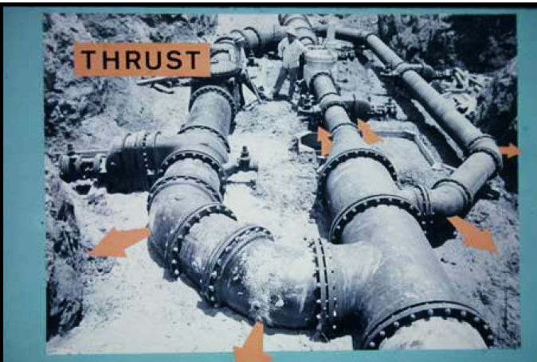
Thrust in Piping Systems
Force of water where changes in fluid velocity, pipe size, or pipe direction occur (such as at fittings, caps, valves, tees, bends, or reducers.

Slide 18
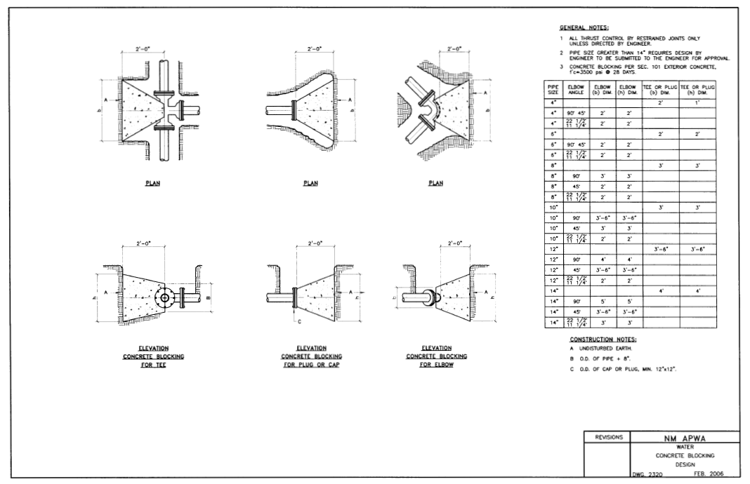
Thrust Blocks
Notes:
A thrust block prevents separation of joints and pipe movement by transferring the resultant thrust force at a bend to the undisturbed soil behind the thrust block. The bearing strength of the soil is expressed in pounds per square foot. Therefore, the area behind the thrust block must engage enough soil area to resist the resultant thrust force at a change in direction.

Slide 19
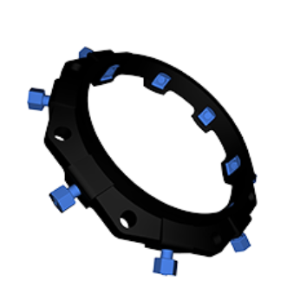
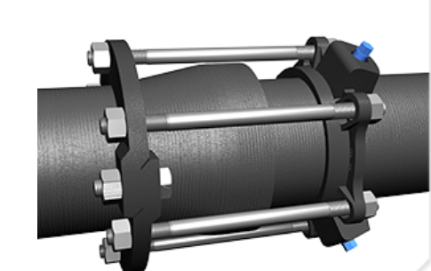
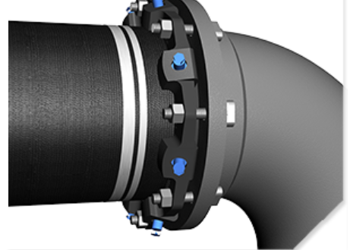
Mechanical Joint Restraints

Slide 20
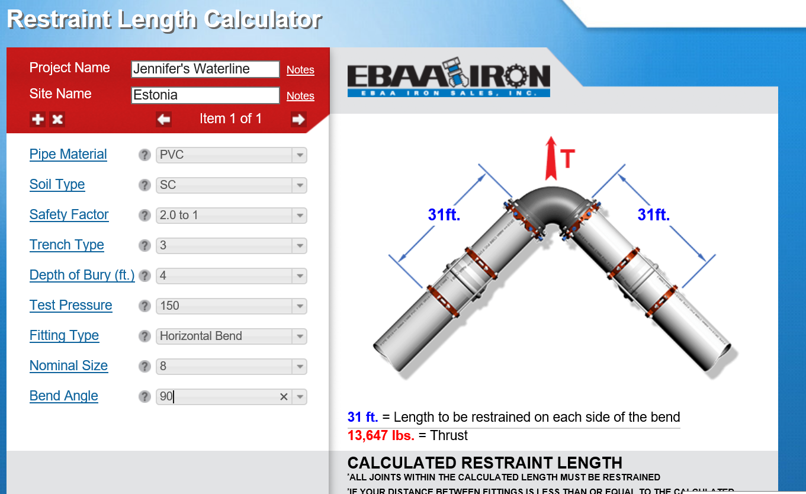
Calculating Restrained Lengths

Slide 21
Separation Distances
Horizontal
  10 feet minimum
Vertical – water over wastewater
  18 inches minimum
Vertical – wastewater over water
  Water-tight 20 ft casing around wastewater pipe
  Water line required to be at least 10 feet from either end of casing
NEED TO REFER TO NMED REGULATIONS AND LOCAL ORDINANCES FOR SPECIFIC SEPARATION DISTANCES
Notes:
Address other potential sources of contamination & how the sanitary survey is used to id these
Mention how urbanization can effect separation distances

Slide 22
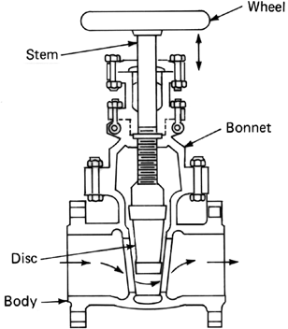
Valves
Uses
  Control flow (rate, direction) and pressure
  Maintenance (isolation)
  Vent
General maintenance
  Exercise at least once annually
  Check for leaks – stem,
  stuffing box

Slide 23
Types of Valves
Gate – CTC, CTO
  Isolation
  NOT for flow control
  Least friction loss when open
Butterfly
  Isolation
  Easier to open than gates (1/4 turn)
  Can be used to control flow
Ball or plug
  Similar to butterfly
  2nd most common valve: corp and curb stops
  Usually not used in sizes >2½-inches
Notes:
Gate - most common. Throttling will damage the valve face

Slide 24
Types of Valves (continued)
Check
  Swing in horizontal; lift in vertical
  Discharge side of pumps; foot valves
Air release
  Vent
Globe
  Flow control (2-way)
  Mixing (3-way)
  Hydraulically operated, diaphragm-actuated
Notes:
Check - when the flow of water should be in one direction only. Footvalves - used in the bottom of the piping to prevent loss of prime.

Slide 25
Control Valves
Altitude
https://www.cla-val.com/documents/pdf/E-210-03.pdf
https://www.youtube.com/watch?v=vWyApKcGqVw
  Closes when storage tank full
  Required for systems that contain several tanks at
  different elevations
Pressure reducing
https://www.youtube.com/watch?v=oFXW-rJQJrA
https://www.youtube.com/watch?v=NQqZYWDS6aw (start-up)
  Reduces/maintains steady downstream pressure
  Min/max ranges
  Improper sizing can cause water hammer

Slide 26
Control Valves
Pressure relief
https://www.youtube.com/watch?v=bvp7Zqls7Fw
  Provide protection against high pressures that may develop
  Used in conjunction with pressure reducer
  Acts as by-pass (cross-connection potential)
Pressure sustaining
https://www.youtube.com/watch?v=rOKJokoWttM
  Throttles (restricts) flow to maintain user-defined upstream pressure
    Upstream pressure increases
    Downstream pressure decreases
    Example; maintaining pressure in upstream multistory building

Slide 27
Hydrants
Fire insurance rates
  Maximum 500 to 600 feet residential spacing
  Minimum 6-inch lines
  Dead ends
  Operated every 6 months, flow tested annually
Other uses
  Flush, vent lines
  Pressure and flow testing
Notes:
Never use main valve of dry barrel to throttle flow – anytime main valve not completely open drain hole will open & jetting water from drain hole can undermine soil in vicinity of hydrant

Slide 28
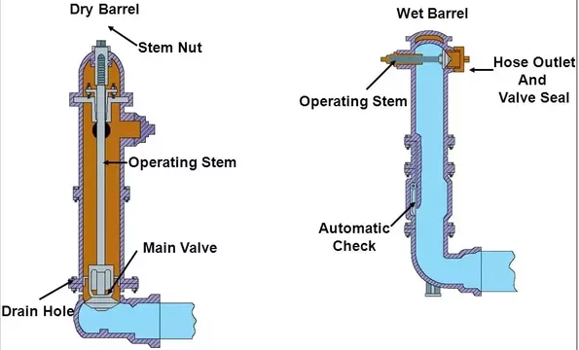
Hydrants (continued)
Wet barrel
  Always pressurized; main valve at top
Dry barrel – used in freezing conditions
  Bottom main
valve
  Drain hole –
potential
cross-connection
Notes:
Never use main valve of dry barrel to throttle flow – anytime main valve not completely open drain hole will open & jetting water from drain hole can undermine soil in vicinity of hydrant

Slide 29
AWWA Fire Flow Standards
Distribution
  6-inch minimum diameter lines
Storage
  1,250 gallons per minute for 120 minutes
  (2 hours) = 150,000 gallons
Notes:
International fire code - 3000gpm for 3 hours for non-residential - that means 540,000 of storage.

Slide 30
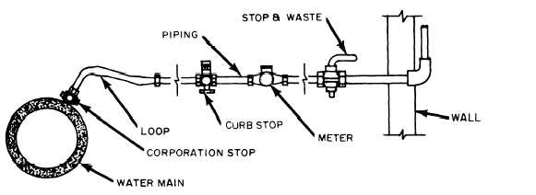
Services
Corporation stop
  “Hot” or “wet” tap into pressurized water line
  Direct tap or saddle strapped to line
  45-degree angle from horizontal - protect from backhoe

Slide 31
Services (continued)
Service line
  Copper, PVC, PE
  Galvanized and lead service lines should be replaced
  Bend to allow flex if pipe settles or shifts
Curb stop (copper shut-off valve)
  Located in easement for service isolation
  Meter stop can be used instead of curb stop
Meters and service lines must be installed below frost line

Slide 32
Service Meters
“Cash Registers”
Worn or broken meters under-register flow
Test a selection of customer meters annually:
  Recalibrate
  Repair
  Replace
Accuracy for most meters should be +/- 1.5 percent

Slide 33
Types of Service Meters
Positive displacement
  Most common; applications up to 2 inches
  Fill/empty cycle of calibrated chamber
  Displaces disc (nutating) or oscillating piston
  Disc or piston action transferred to head by
  gears or magnetic drives
Notes:
PD service meter similar to chem feed PD meter

Slide 34
Types of Service Meters (cont.)
Turbine or rotor
  5/8” and larger, low pressure applications
  Dependable with relatively low head loss
  Water velocity proportional to turbine rotation
  Turbine shaft connected to meter register
  Multi-jet meters for low flow applications

Slide 35
Types of Service Meters (cont.)
Venturi
  High flow applications
  Measures difference in pressure head at throat
  (conservation of energy, Bernoulli equation)
  Low head loss; very dependable (no moving
  parts)

Slide 36
Types of Service Meters (cont.)
Compound meter
  Two-in-one meters
  Displacement meter for low flows
  Turbine meter for higher flows
Magnetic Meters
  No moving parts
  Applies a magnetic field – measures
  potential difference
Notes:
Compound meters need to be serviced and checked that both high and low are registering.

Slide 37
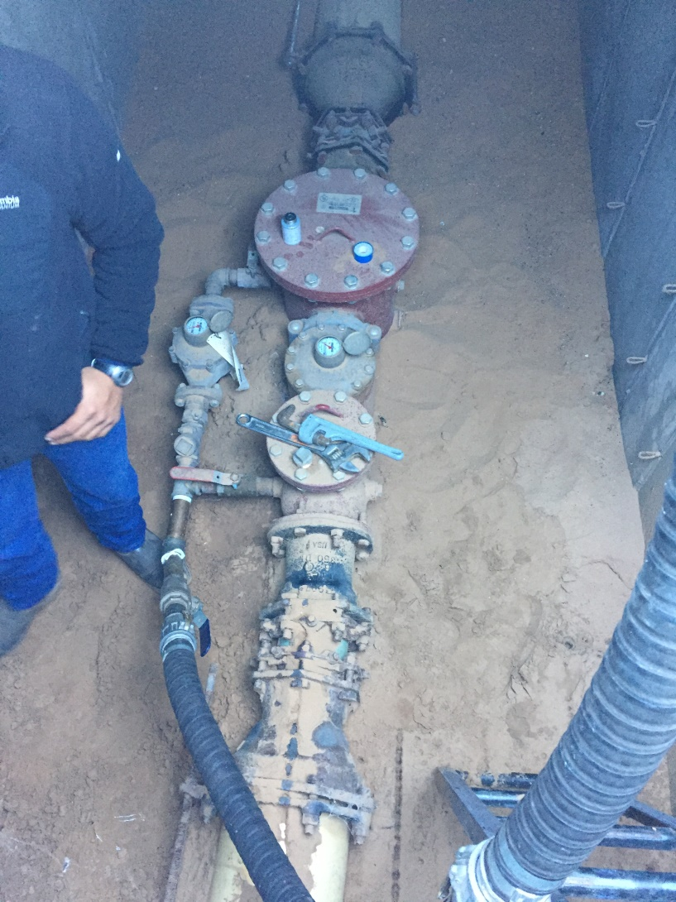
Meter Installations & Accuracy
Generic recommendation:
10 pipe diameters straight pipe upstream and 5 downstream
Meter accuracy varies by type (magnetic most accurate)
Size must be appropriate for actual flow experienced
Age matters (more with mechanical meters)

Slide 38
Line Repairs

Slide 39
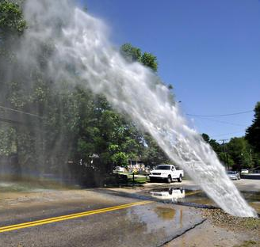
Line Repairs
Line breaks
  Disruption of service - PR
  Water loss = revenue loss
  Cross-contamination
Leak Detection
  Observation (greener grass/weeds)
  Report (by customers)
  Line isolation (in rural areas, at night)
  Comparison between production and billing
  Rapid drop in storage
Notes:
We’ll talk about leak detection in the afternoon.

Slide 40
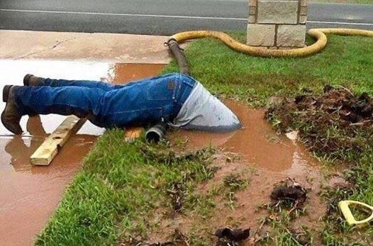
Line Repairs (continued)
3 Steps
  Leak location (often occurs at the joints)
  Repair
  Disinfection (repair or new construction)
SOPs
  Customer notification
  Health & safety
  Maintenance activities
  Emergency repair call-outs
  Recordkeeping
Notes:
health and safety- isolation valve LOTO, shoring practices and ladder placement. Have a sump hole
maintenance - wrap around if there’s a puncture hole, cut out and install new pipe with couplings of cracks along the length, flush the line to remove foreign matter
backfill with appropriate materials
refill the line SLOWLY, velocity below 1 fps.
disinfect and take bac-T

Slide 41
Backfill
Type of material important
  Abrasive, sharp edges
  Sand
  First lift - tamp when pipe half exposed
  Second lift - again when pipe covered by ~ 6”
Steel conduit
  Protects pipe (especially plastic) from vibration and stress loadings (under railroads, highways)
    Easier to repair, replace
Metal tape, 12-gauge Cu wire
  Mark plastic line for metal detection
  Install after tamping second lift, before refilling trench
Notes:
Mention glass recycling and crushing to make sand - ideal for backfill material

Slide 42
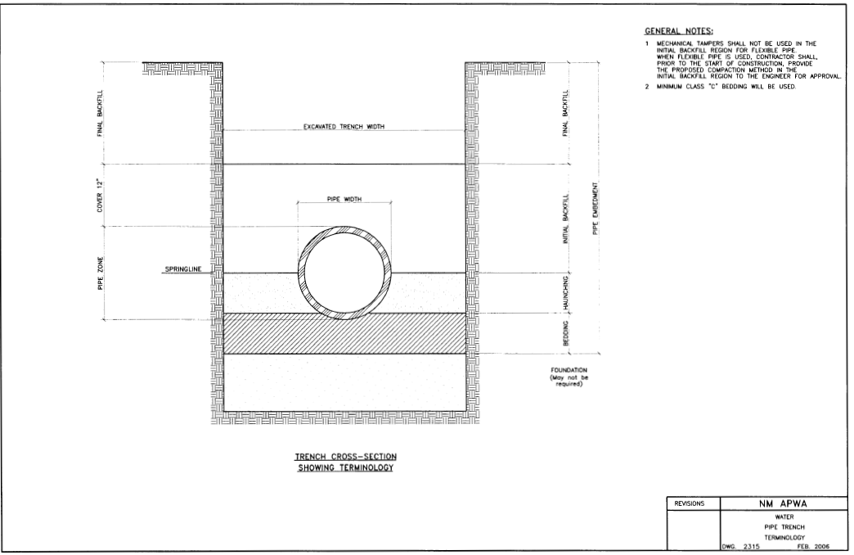
Trench Detail
6 to 12”
Backfill
Bedding

Slide 43
Disinfection of New and Repaired Lines
AWWA Standard C-651 or 10 state standards
Flushing
  Minimum velocity – 2.5 feet per second
  2 times pipe volume minimum
Disinfect with chlorine
  Usually start with 50 mg/L dosage
  Target 5 mg/L residual 24 hours after dosage
  added
  Can increase dose to achieve residual with shorter contact time (critical line)
Flush to remove chlorinated water
Collect Bac-T sample(s)
Notes:
If can’t keep line isolated while waiting for Bac-T results, can flush with water that has a 0.5 – 1.0 mg/L free chlorine residual
Collect Bac-T sample(s)
Maintain this residual in line until negative sample results are obtained
Then operate line as usual with rest of distribution system

Slide 44
Taking care of your system

Slide 45
Operational Objectives
Determine potential for degradation of water quality in distribution system
  Reliability
  Quality
  Quantity
  Vulnerability of distribution system
Ensure sampling/monitoring plans conform with requirements and adequately assess water quality in distribution system

Slide 46
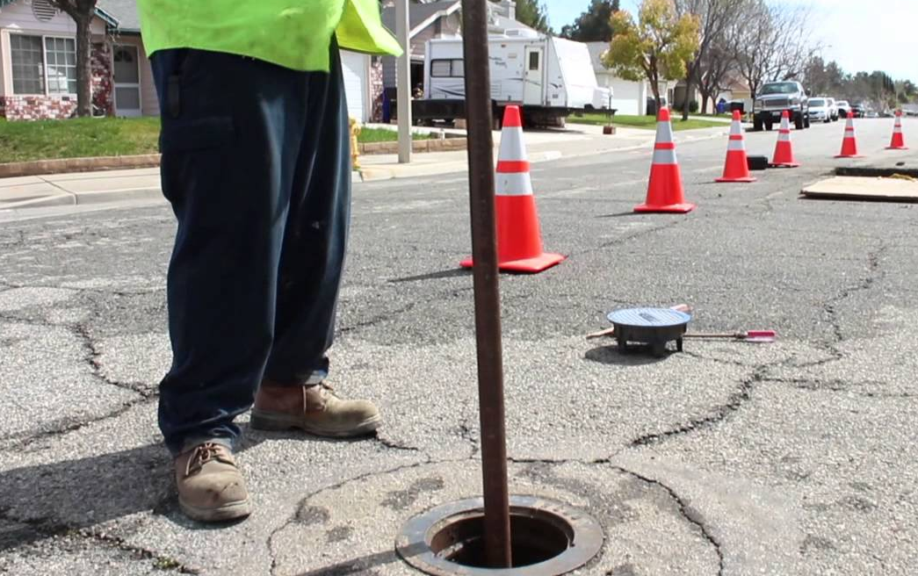
Valve Maintenance Data
Map of system showing valve locations
  Make, type, and size
  Number of turns to open/shut
  Exercise date(s)
  Maintenance date(s)
  Condition of the valve
Notes:
We’ll look at mapping more closely in the later section.

Slide 47
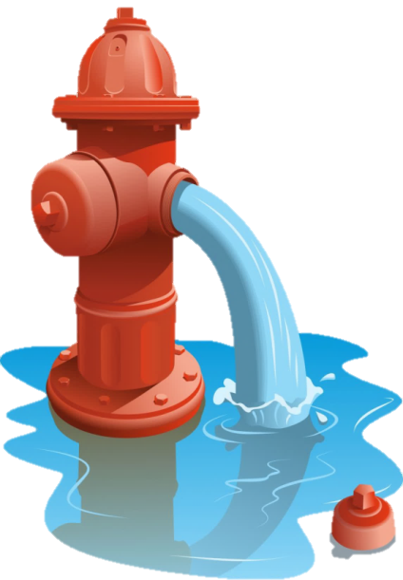
Line Cleaning
Flushing
  Spot Flushing - Reactive. Most common type of flushing. Responding to customer complaints
  Stagnant Area Flushing - Short term preventative. Used in areas with longer detention times (dead ends, low demands
  System-wide Flushing - Long term preventative. Most comprehensive form of flushing. Maintains water quality and useful life of mains.
Notes:
Mostly done by flushing.

Slide 48
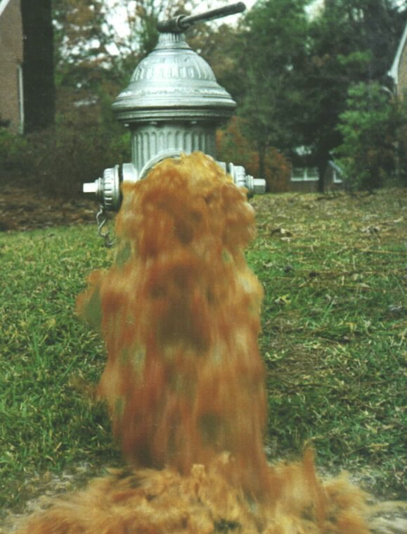
Line Cleaning
Routine flushing
  When to flush?
    monthly, quarterly, annually?
    before and after main disinfection
    in response to complaints
    in response to reg violations (bac.t, low TCR)
  Valve inspection and exercising
  Hydrant inspection and operation
  Where to flush?
Notes:
Where? Entire system, or just problematic areas (dead ends, complaint areas, poor quality water etc.)

Slide 49
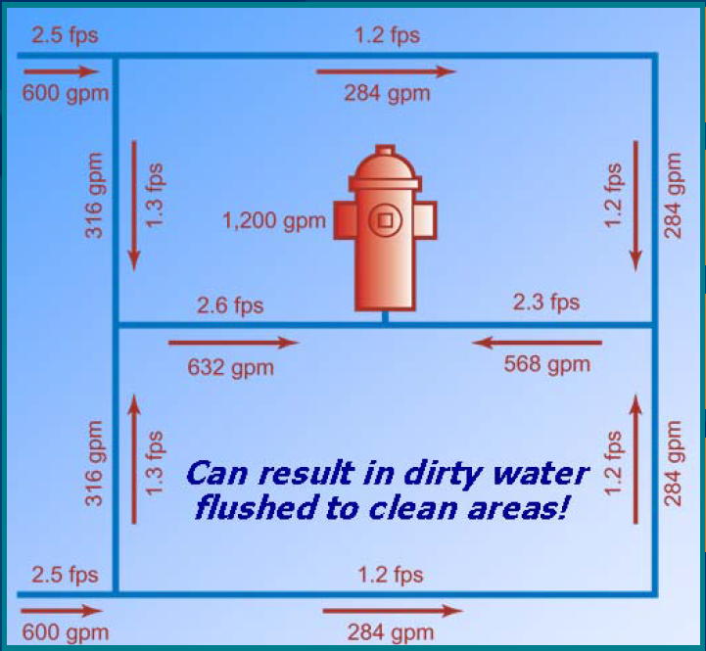
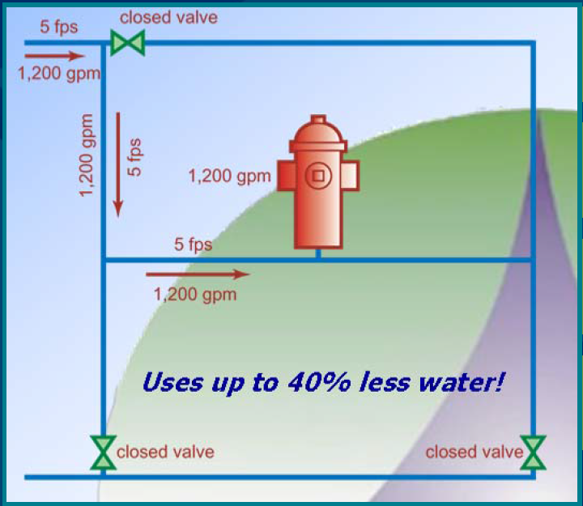
Line Cleaning
Unidirectional Flushing
Notes:
Conventional Flushing - water from all directions, low velocities, less scouring, don’t control flushing direction
Unidirectional Flushing - water is channeled, higher velocities, better cleaning, systematic, valve operation.

Slide 50
Line Cleaning
Unidirectional Flushing - What data will you need?
complaint records
flushing data
fire hydrant testing
water quality data
maintenance records
records of high flows
condition of mains
Notes:
WQ data - records of color, odor, turbidity, bac.t. chlorine residual, DO, pH, temperature. Collect samples during flushing
Maintenance records - valve/main replacements, relining mains, valve inspections etc.
High Flows - main breaks, fires..

Slide 51
Line Cleaning
Unidirectional Flushing - How it works?
  Develop a flushing plan for each area (system maps!!!!)
  Inform sensitive customers
  Confirm storm drains or natural water courses can handle the flow
  Close valves to isolate section from the rest of the system
  Flush one small section at a time
  Open hydrant slowly until the desired flow is obtained
  Keep flushing velocities 2.5 - 12 fps, maintain min 20 psi
Notes:
Sensitive customers - hospitals, other medical facilities (i.e. dialysis), food processing, specialized manufacturing that uses ultrapure water.
Low velocities for discolored water, higher velocities for sediment removal

Slide 52
Line Cleaning
Unidirectional Flushing - How it works?
  Flush from the source towards periphery
  Flush at night when possible
  Record data
  When water clears, close hydrant slowly
  Reopen valves
  Proceed to the next section
Video in YouTube

Slide 53
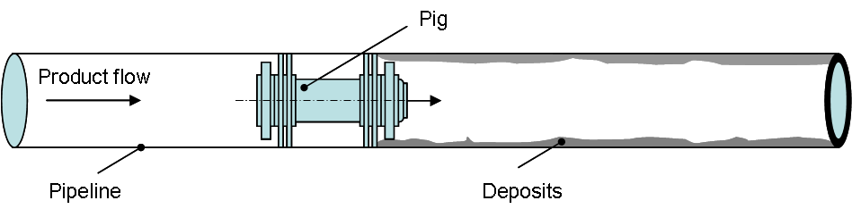
Line Cleaning
Pipe pig
  Bullet-shaped foam swab
  Pushed through pipe using water pressure
  Special launch sites
  Extraction points

Slide 54
Mapping
Understanding your system
Preserving the knowledge
DSSP, Emergency Response Plan, O&M Plan, Flushing Program, Asset Management, etc.
Maps should include:
  locations of all the water system facilities
  pipes (size, material, age, condition)
  valves
  service connections, water meters
Notes:
There’s a variety of things you can map, for example, pressures, WQ data, leaks, breaks, customer complaints.

Slide 55
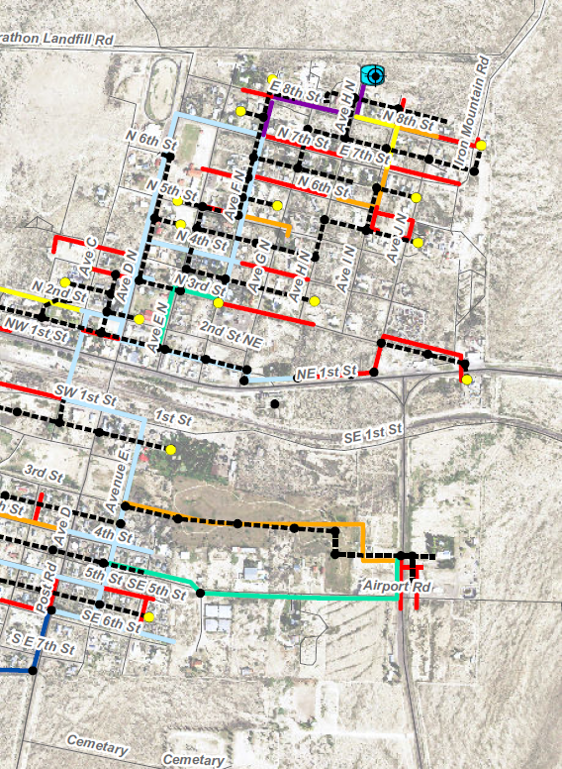
Mapping
Mapping tools:
  Google Maps
  Scribble Maps
  ESRI Free Trial
  ESRI ArcGIS
Notes:
What kind of maps do you have? With what info?
ArcGIS Online too is $42/mo. charged annually
Pull up Google Maps

Slide 56
Asset Management

Slide 57
Asset Management: A Process
"Asset management is managing infrastructure assets to minimize the total cost of owning and operating them while continuously delivering the service levels customers desire."
—from the publication Managing Public Infrastructure Assets
Notes:
If I have $1 to spend, where should I spend it?
It’s using good data to make decisions.

Slide 58
Why do you need Asset Management?
Regulatory requirements
  CMOM (Capacity, Management, Operation and Maintenance Programs for Sanitary Sewer Collection Systems)
  GASB 34 (Governmental Accounting Standards Board Station No. 34)
  NMFA (New Mexico Finance Authority)
Save cost on replacement by extending the life of assets
Some funding sources require an AM Plan
Notes:
Some examples of regulations that have prompted the development of Asset Management programs include:
CMOM - capacity, management, operation and maintenance (CMOM) programs for municipal sanitary sewer collection systems.
GASB 34 Governmental Accounting Standards Board 34 addresses how utilities report their assets and the value of those assets.
In NM, The NM Finance Authority has recently taken a position that Asset Management will be required for funding of utility projects.

Slide 59
AM Core Components
1. Asset Inventory/Condition
5. Funding Strategy
2. Level of Service
Asset
Management
4. Life Cycle Costing
3. Critical Assets
Notes:
Let’s use a Groundwater well as an example.
This diagram illustrates the 5 core components of asset management.
Current condition - Prepare an inventory and determine what each well’s condition is. What is its value and useful life? This should include an assessment of current well performance and water quality. These data may then be compared with earlier measurements to see if there has been any deterioration.
What is the required level of service? Is there adequate redundancy in the system to allow a well to fail? Or how long could it be out of service? For a water utility the required level of service generally means being able to provide water 100% of the time.
Which assets are critical? - Based on its age and condition, how likely is a particular well to fail? And then what would be the consequences of failure? They would likely include repair or replacement costs and possibly other impacts such as a reduced level of service, loss of public confidence, or lost revenue.
Minimize life cycle costs - Perform cost-benefit analysis and evaluate how replacement costs compare with maintenance and rehabilitation costs. For example, is it cheaper over the long run to simply run a well to failure and then replace it? Or will periodic maintenance and rehabilitation increase the useful life enough to offset these recurring costs? This assessment needs to consider actual operating costs that can be impacted by deteriorating well performance over time.
Develop funding plan - to cover maintenance, repair and replacement costs taking into account level of service requirements and escalated cash flow and cost estimates.
The circle indicates that this is an ongoing process that requires periodic reevaluation.

Slide 60
Asset Management Questions
What assets do we have and where are they?
What are they worth?
What is their condition?
What do we need to do with them?
When do we need to do it?
How much will it cost?
How will we finance it?

Slide 61
Asset Management Benefits
Increased knowledge of assets, including which ones are the most critical
Data-driven decision-making
Understanding of the relationship between preventive maintenance and replacement
Consideration of the capacity of the asset when deciding to repair or replace

Slide 62
Water audit and leak detection

Slide 63
AWWA Water Audits
M36 Method for conducting water audits:
Audit looks at:
  Production
  Billing
  Budget
  Data collection
Based on an audit - where is water lost? (real vs apparent)
Notes:
Accounting for every drop of water.

Slide 64
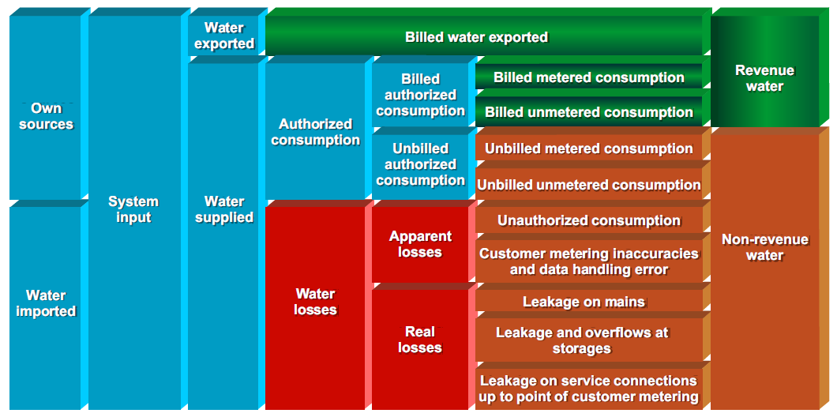
AWWA Water Audits (continued)

Slide 65
Elimination of Water Loss
Water loss limits – no longer useful thresholds
  ≤ 10% acceptable
  10-15% - some improvement needed
  > 15% unacceptable, serious problem
Reasons for water loss
  Inaccurate or non-working meters
  Leaks
  Illegal taps
  Overflowing tank(s)
Leak detection program

Slide 66
Leak Prevention and Detection
Components
  Selection of appropriate types of equipment – pipes, valves, hydrants, meters
  Proper installation
  Calibration (accuracy)
  Maintenance and replacement
  Data collection and calculation practices
Notes:
Before you spend money on expensive leak detection program, make sure your data is good.

Slide 67
How Much Water is Leaking?
Size of Hole | Gallons Water Per Month*
1/32” | 6,300
1/16” | 25,000
1/8” | 100,000
3/16” | 225,000
1/4: | 400,000
*at 60 psi

Slide 68
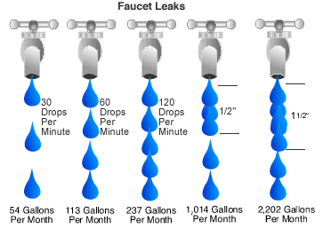
How Much Water is Leaking?
Faucet Leaks

Slide 69
Cross-Connections

Slide 70
Cross Connections
Any link between potable and non-potable water systems that allow contamination to enter the potable system
Contaminants can enter the potable supply when the pressure in the non-potable system is greater than the pressure in the potable system

Slide 71
Cross Connections (continued)
Pressure differential causes 2 types of backflow – back pressure backflow or back siphonage backflow
  Back pressure occurs when the non-potable system has a greater pressure than the potable system
  Back siphonage occurs when there is a vacuum in the potable system causing non-potable water to be siphoned into the potable system

Slide 72
Examples
Backwash drains – filters, softeners
Ice, soft drink machines, HVAC, washing machines
Chemical feed make-up and carrier water
Split-feed (pre- and post-chlorination) system
Water flush for pump bearings
Fire hydrant drain lines

Slide 73
Additional Examples
Old wells
Heating systems – make-up water, glycol
Hose bibs, sinks
Distribution system entry points
Household residential boilers – huge danger
  Rarely serviced, poorly controlled

Slide 74
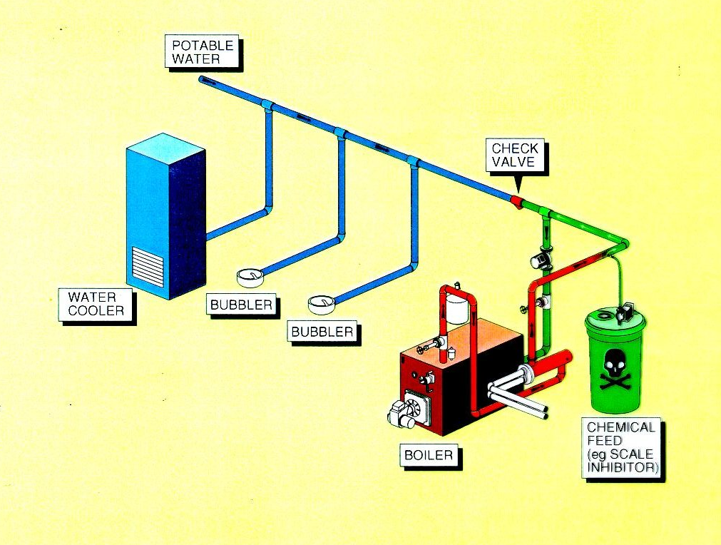
Backflow from Backpressure
Notes:
In this example a boiler has its own loop, separated from the potable water system by a check valve. The boiler system adds a scale inhibitor. If the pressure of the boiler system becomes greater than the pressure on the potable water side of the check valve and the check valve fails, then the water will flow back into the potable water supply from the greater pressure in the boiler loop. A check valve is not an adequate barrier for a toxic scale inhibitor. There should be an air gap or RPZ device here.

Slide 75
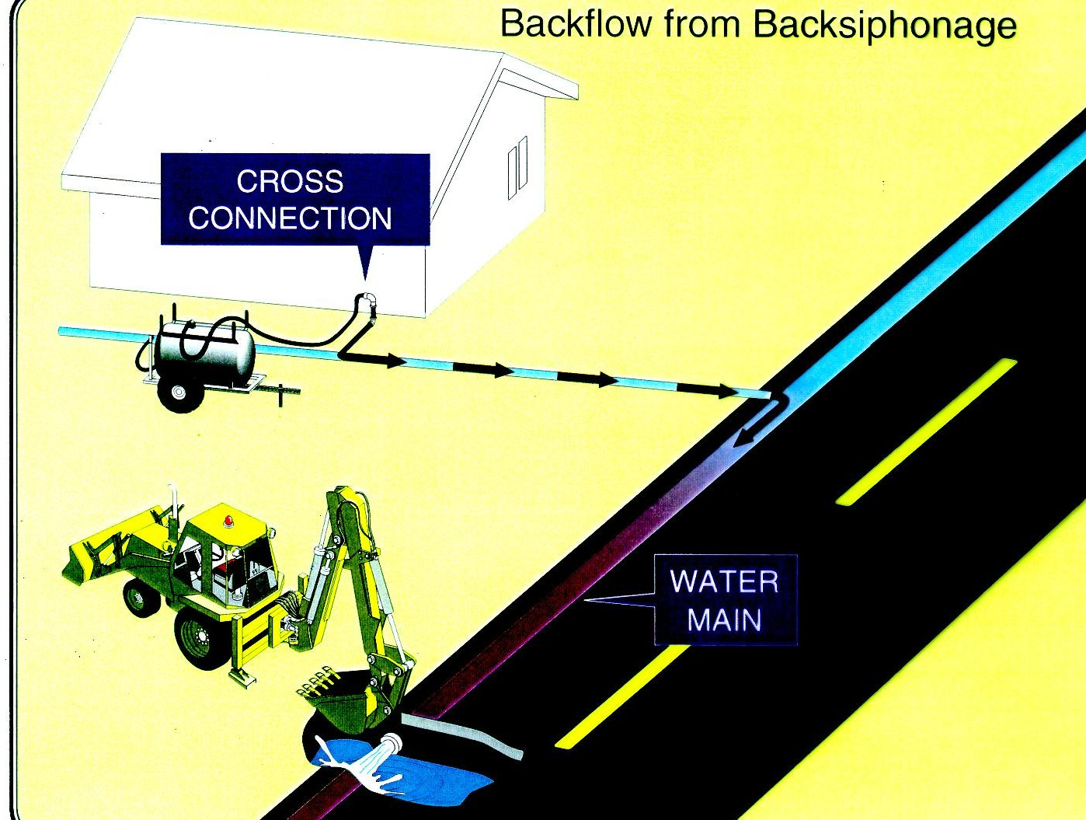
Backflow from Backsiphonage
Notes:
The other type of cross connection is backsiphonage. It occurs when the pressure in the pws drops and siphons unknown quality water into it. In this case a backhoe has broken the pws water main causing the pressure to drop. A hose in a farm truck is submerged in a solution tank. The solution is siphoned through the hose to the water main under negative pressure. We are aware of this type of cross connection happening recently (last 10 years) in Louisiana. Before that it also happened in Oklahoma and Texas in our Region. In the case in Texas some people died. In the Louisiana case a law suit followed and the water system had serious liability problems. The Oklahoma situation ended better, the system had to be flushed for a prolonged period of time but no one became ill.

Slide 76
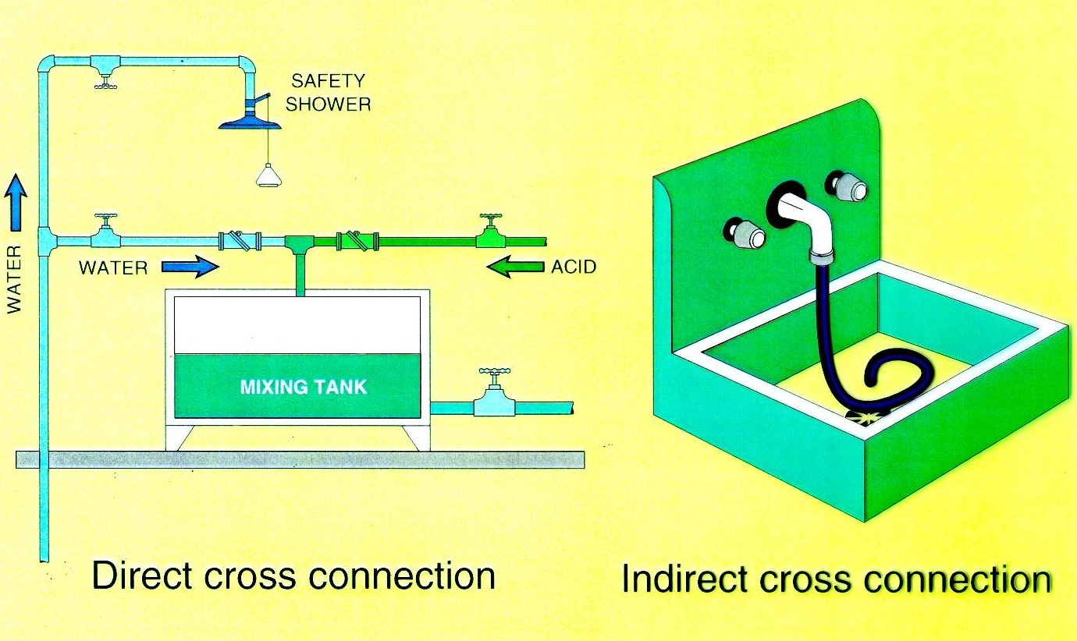
Notes:
A direct cross connection is one that is permanently plumbed into a system. An indirect cross connection is one that may be temporary like a hose lying below the lip of a sink. I have heard of garden hoses referred to as portable cross connections.
These are common cross connections that you see in water plants. The chemical mixing tank cross connection seems to exist at every small plant in our region. Hoses in sinks are also very common.

Slide 77
Protection Against Cross Connections
Adequate distribution system pressures
Air gap
Atmospheric vacuum breakers (AVB)
  Includes hose bib vacuum breakers
Pressure vacuum breakers (PVB)
  Includes backflow preventer w/ intermediate atmospheric vent for ½” and ¾” lines
Double check valve (DCV) assembly
Reduced pressure zone (RPZ) backflow preventer
Institutionalized X-conn control program

Slide 78
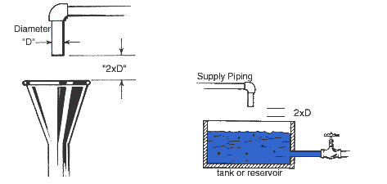
Air Gap
https://www.youtube.com/watch?v=FpZd0ZmBI4A (0:00 – 1:23)
Notes:
The best cross connection protection device is an air gap. It never fails if it is arranged at a 2D distance.

Slide 79

Notes:
This type of device can be used to assure an airgap is in place at the end of a watering station.

Slide 80
Reduced Pressure Zone Backflow Preventer
Most reliable mechanical device
  Creates an air gap
High hazard protection
Used on all direct connections for back pressure and back siphonage
Must be inspected and tested annually by certified personnel

Slide 81
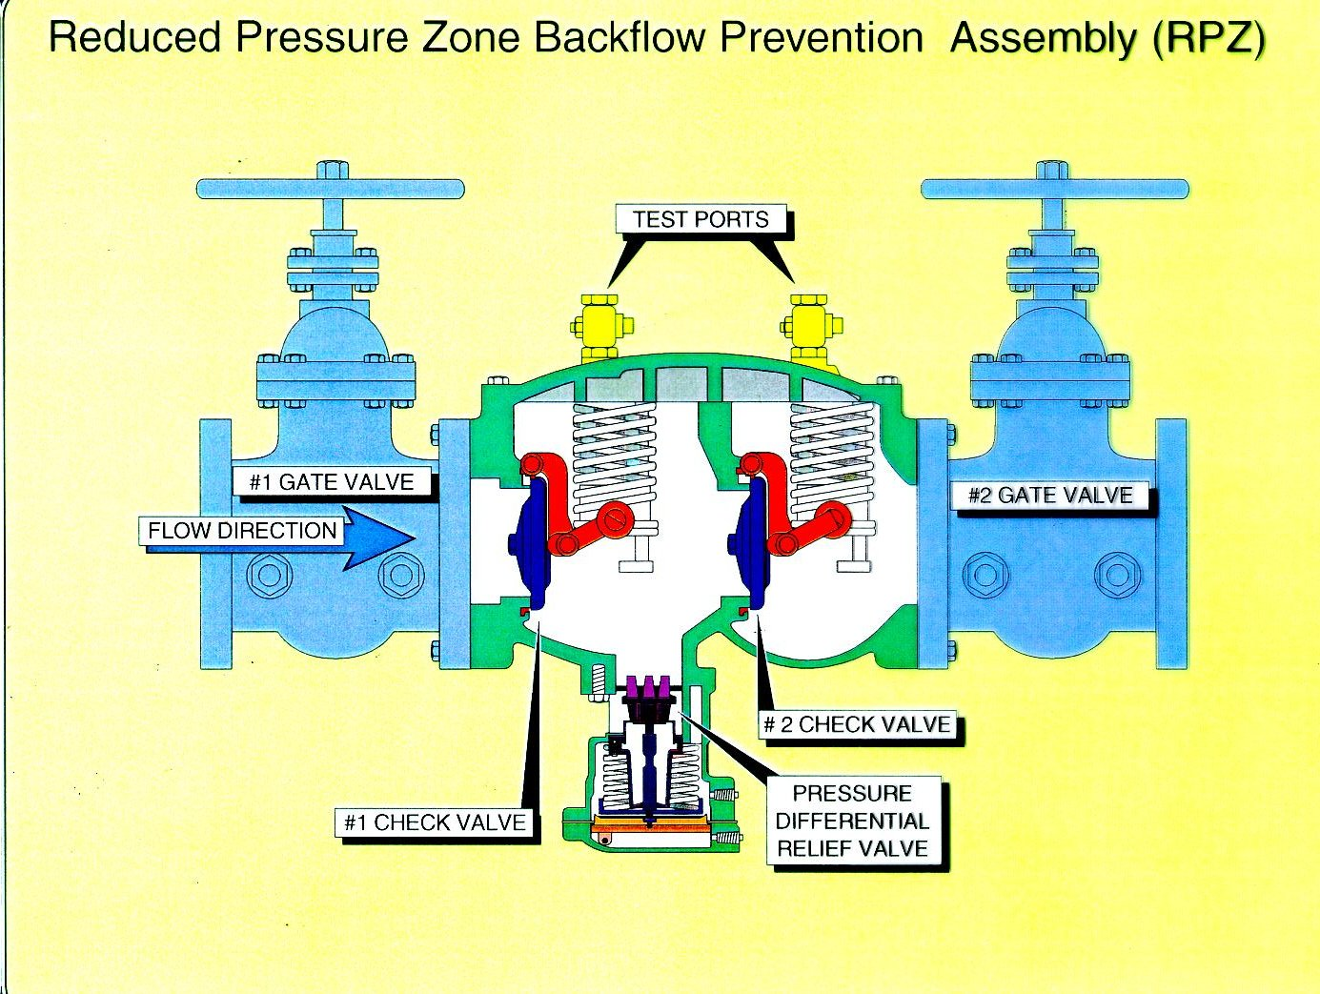
Reduced Pressure Zone Backflow Prevention Assembly (RPZ)
https://www.youtube.com/watch?v=FpZd0ZmBI4A (1:24 – 5:51)
Notes:
An RPZ is the only mechanical device that is suitable for high hazard situations ( An air gap is still better). It incorporates two check valves and a vacuum breaker in between them. There are test ports for testing each of the three elements. These have to be installed right side up so the vacuum breaker will work. Whenever the system is pressured up it should spit out the vacuum breaker momentarily (until it closes) and then stop. if it flows continually out the middle port, the vacuum breaker is not functioning and at least one of the check valves is not functioning

Slide 82
Double Check Valve Assembly
2 independently operating, internally loaded check valves
2 tightly closing shut-off valves
4 appropriately located test cocks
Back siphonage and back pressure protection
  Protection for low levels of hazard
  Non-potable source is polluted, not contaminated
Operates with low head loss
Must be inspected and tested annually

Slide 83
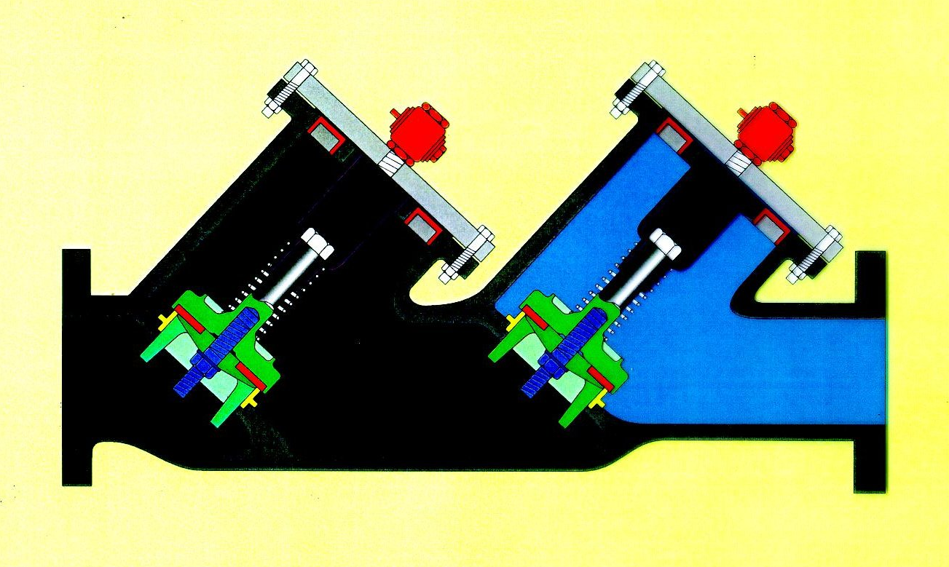
Double Check Valve
https://www.youtube.com/watch?v=FpZd0ZmBI4A (5:52 – 6:59)
Notes:
This is a double check valve. This graphic shows the water on the right unable to backflow against the first check valve. If the first on fails there is a back up. Because check valves can stick, they are only suitable for low hazard situations.

Slide 84
Atmospheric Vacuum Breaker
Incorporates atmospheric vent in conjunction with a check valve
Supply of potable water seals off vent
Negative pressure in supply line permits check valve to seal the orifice
At the same time the vent opens allowing air to enter the system to break the vacuum
Can be used where the vacuum breaker is never subjected to back pressure and is installed on discharge side of the last control valve above the usage point
Cannot be used under continuous pressure – check valve tends to ‘modulate’ permitting backflow
Low hazardous application only
Notes:
An atmospheric vacuum breaker is ok in Non health related situations. It will prevent back siphonage but not backflow. It must be put in vertically so gravity will cause it to close under siphonage conditions. These are subject to failure if they get dirty and stick open.

Slide 85
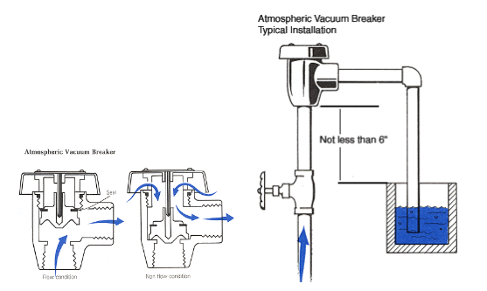
Atmospheric Vacuum Breaker
https://www.youtube.com/watch?v=FpZd0ZmBI4A (7:00 – 8:16)
Notes:
An atmospheric vacuum breaker is ok in Non health related situations. It will prevent back siphonage but not backflow. It must be put in vertically so gravity will cause it to close under siphonage conditions. These are subject to failure if they get dirty and stick open.

Slide 86
Pressure Vacuum Breaker
Assembly consisting of an inlet valve with a spring loaded poppet, a spring loaded check valve, 2 test cocks, and 2 shut-off valves
For use in pressurized systems
Operates only when vacuum occurs
Designed to operate for extended periods under continuous pressure
Should not be subjected to back pressure
Must be installed a minimum of 12 inches above highest outlet
Must be tested annually
Can be used for intermediate/high hazard applications where air gap not possible

Slide 87
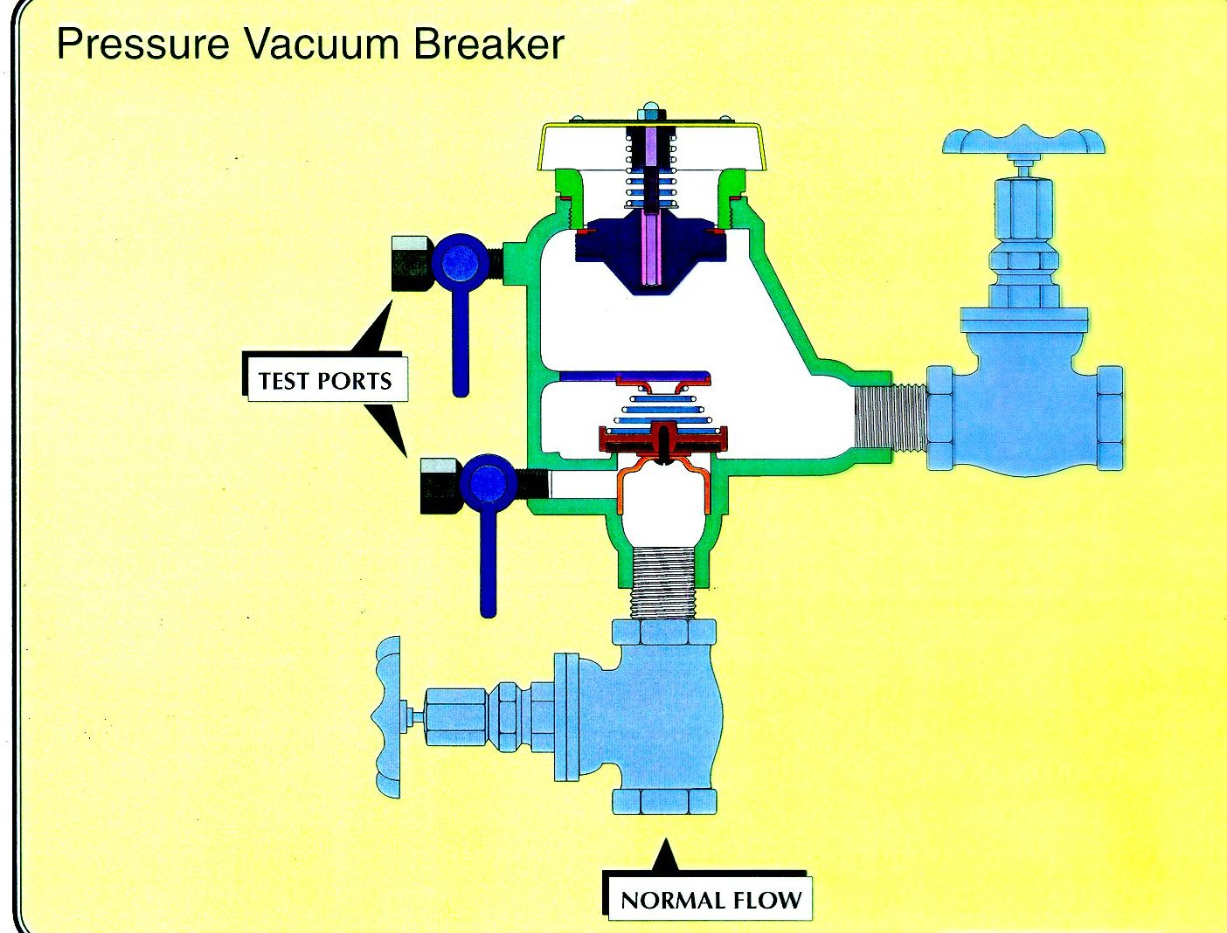
Pressure Vacuum Breaker
https://www.youtube.com/watch?v=FpZd0ZmBI4A (8:17 – 9:01)
Notes:
This device incorporates a check valve and an atmospheric vacuum breaker. A check valve will prevent back flow. It is also subject to sticking open however. If you have a device like this it should prevent back flow and back siphonage if it is working properly. The test port make it possible to check its effectiveness. It would be appropriate for intermediate hazard conditions.

Slide 88
Cross-Connection Examples

Slide 89
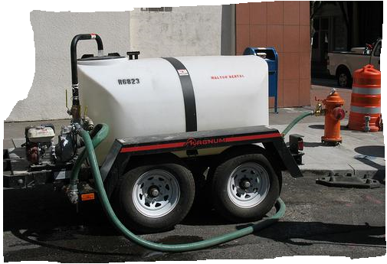
Air Gap

Slide 90
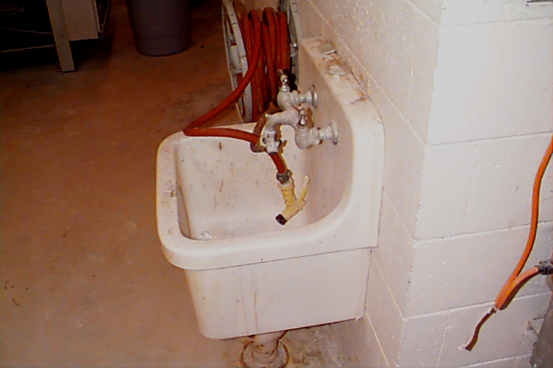
Notes:
This is a potable water line attached to a hose that is submerged in a floor drain.

Slide 91
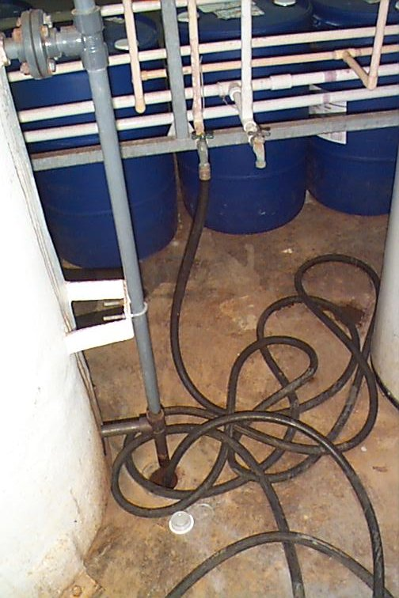
Notes:
This is a potable water line attached to a hose that is submerged in a floor drain.

Slide 92
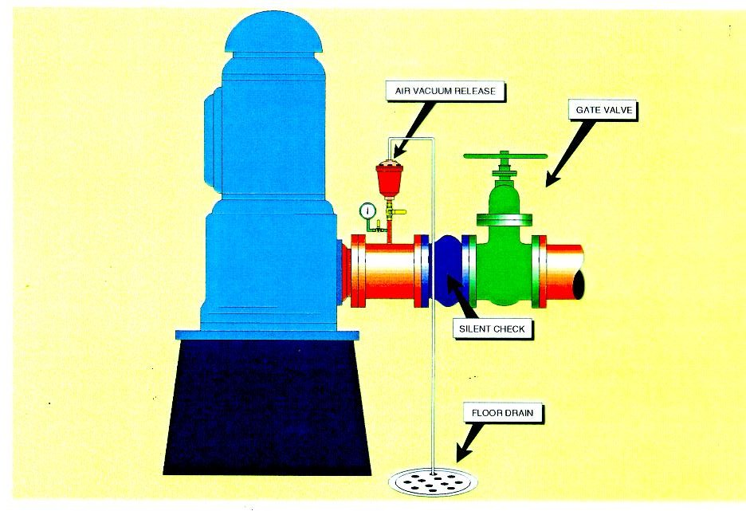
Pumping Station Cross-connections
Priming of raw water pumps with finished water
Air relief valves piped directly to a drain
Cooling water for an emergency generator submerged in a drain or returned to the potable supply
AIR VACUUM RELEASE
GATE VALVE
SILENT CHECK
FLOOR DRAIN
Notes:
At pumping stations also there are cross connections that can occur.
As we said earlier, when a pump comes on the air release valve usually spits water and air for a second or two. At some water plants the operators will unknowingly plumb the air relief discharges into a sewer or drain to avoid getting the water on the floor.

Slide 93
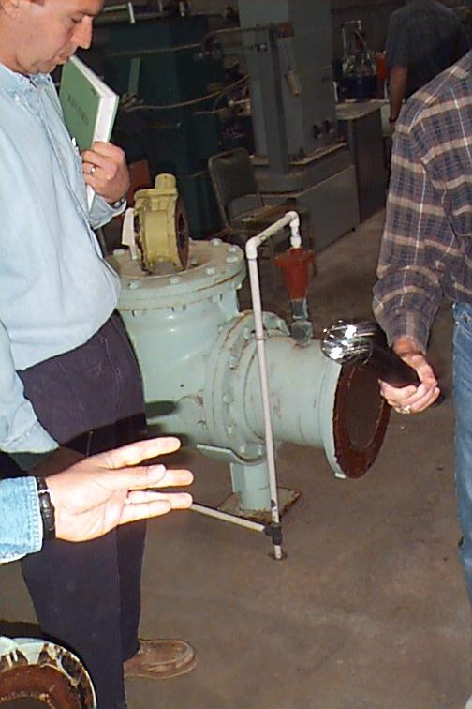
Air Release Valve Plumbed Directly to Drain
Notes:
This is an example of an air release valve plumbed directly into a drain. In this case it was a clear well and the hole opened a conduit into the clear well from above.

Slide 94
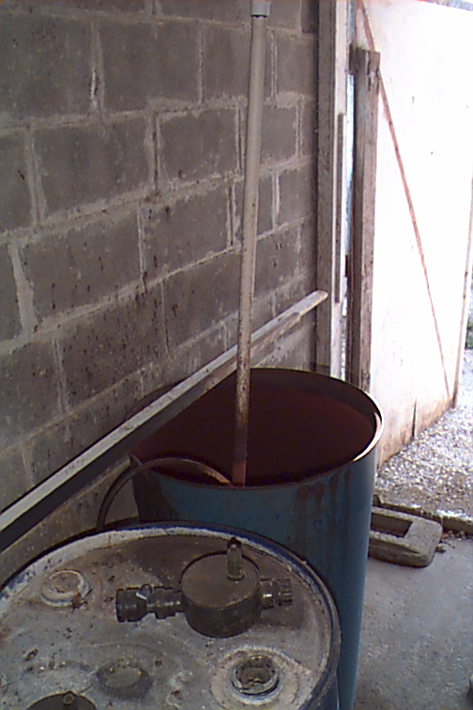
Notes:
This is a submerged make up water inlet in a barrel that is used to add permanganate to a PWS. Again not a serious health threat but it could screw up some of the chemistry.

Slide 95
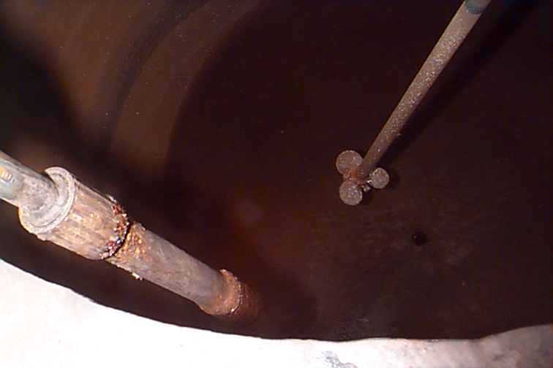
Notes:
This is a close up of the last photo showing the submerged inlet.

Slide 96
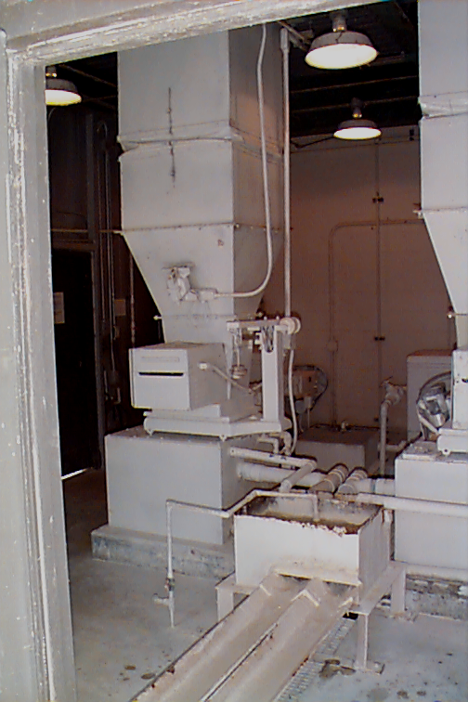
Notes:
This is a submerged inlet on a lime slurry feeder. The line to the left is a potable water line with a check valve on it. That check valve is the only protection against backflow in this line. It is not a proper device for this type of chemical. As you can see in the mixing chamber the potable water outlet is submerged.

Slide 97
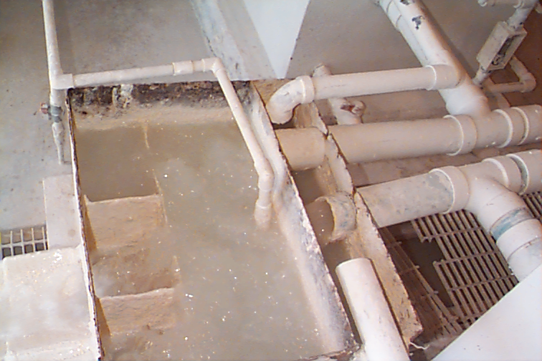
Notes:
This is a close up of the same feeder. The check valve is behind the mixer. The inlet is obviously submerged.

Slide 98

Clear Well or Storage Tank Overflow
Clear Well or Storage
Tank Overflow
Notes:
This is actually an overflow from a clear well in a stream but often you will see hoses hooked up to fire hydrants or other orifices that are submerged in streams so the blow off does not flood a neighborhood.

Slide 99

Distribution System
Distribution System
Fire hydrant drain to sewer
Fire hydrant drain to sewer
Notes:
Fire hydrants must drain after they are used and usually they have weep holes around their base. If the weep holes are plumbed directly into a sanitary sewer it can be a problem.

Slide 100


Slide 101


Slide 102

Notes:
This is the top of the same watering station where we can a the hose end. There is no devise that would guarantee the air gap.

Slide 103


Slide 104


Slide 105

Notes:
As you can see there is a steady stream in this one so the device is failing.

Slide 106

Air gaps – good & not so good

Slide 107
Any Questions?

